Slide 1
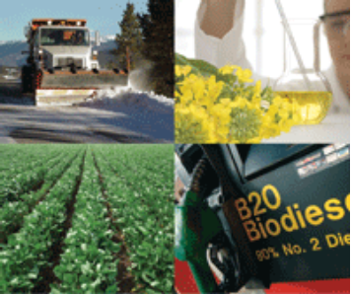

BIO 1.0 Biodiesel Industry Overview and Benefits
Notes:
Welcome to today’s training session on Biodiesel. This session an introductory session on biodiesel, a relatively new renewable diesel fuel made from vegetable oils and animal fats. This training has been developed by technical experts and mechanics at the National Biodiesel Board (NBB for short)—and fine tuned through input provided by the over 2500 diesel instructors and technicians who have taken this course over the last 5 years. It is part of a larger training program targeted for diesel mechanics and instructors, and the NBB Biodiesel For Diesel Technicians training program is diesel technician training that is accredited through the Continuing Automotive Service Education (CASE) program administered by ASE/ ATMC (Automotive Training Managers Council) . NBB provides this training information at no cost to attendees, and we would like to thank NBB and its sponsors.

Slide 2

Topics for Today
  What is Biodiesel?
  Biodiesel Benefits
  Biodiesel Sustainability
  OEM Acceptance
  Biodiesel Resources
Notes:
Today’s Biodiesel for Diesel Technicians session is focused on providing the basics of biodiesel that are beneficial for a diesel mechanic who just desires a cursory knowledge about biodiesel, why your customers might want to use it, some facts and technical details about biodiesel that have been well studied but are probably new to someone who hasn’t been intimately involved in the biodiesel industry. It will also go over the current status of biodiesel with the diesel engine and equipment manufacturers.
In the session today we will provide a quick overview of the National Biodiesel Board, who developed this ASE/ATMC accredited Biodiesel for Diesel Technicians program. We will also describe what biodiesel is made from, how it is produced, and exactly what it is--and perhaps more importantly what biodiesel is not! We will go over the current size and status of the biodiesel industry, the major benefits of biodiesel and why some people are really excited about using it, and how these benefits have made their way into various incentives and laws that help to level the playing field for biodiesel and make the cost of biodiesel to the end user essentially the same as diesel. We will also cover how the biodiesel industry actually helps to give us more food—not less—and is one of the most sustainable fuels on the planet. We will cover the most popular blends and the positions of the various engine and vehicle manufacturers on support levels and/or recommendations for biodiesel blends.
Lastly, we’ll go over some resources that are available and that you can access for on-going support and questions, as well as our on-line version of this course.
FOR GROUPS NEW TO THE INSTRUCTOR (OPTIONAL, depending on time available): Before we begin, lets go around the room and have each person introduce themselves, what company or organization (or class if students) you are from, and your experience with biodiesel and/or what you would like to get out of this class.

Slide 3
Learning Objectives
    Provide an overview training seminar about the biodiesel industry and its current status, why customers are interested in biodiesel, and the research that has gone into developing biodiesel over the past 20 years.
    Provide access to industry experts for more detailed questions and answers about biodiesel
    Introduce the National Biodiesel Board’s Diesel Technician Training program and the program resources to the audience
Notes:
The learning objectives for this session are outlined here.
Read slide as shown.

Slide 4
Learning Outcomes
    Be able to answer general questions about biodiesel that you may be asked as a technician
    • Be able to identify the key reasons why customers want biodiesel
    • Be able to explain the importance of biodiesel fuel quality and the BQ-9000 program
    • Understand the OEM positions on use of biodiesel blends
Notes:
At the end of today’s session, which is primarily focused on providing you the information you need to answer general questions about biodiesel that you might be asked as a technician, you will be able to do the following.
First, you will be able to identify and understand the key reasons why biodiesel is gaining popularity and why customers might want to use biodiesel. This will include both overall benefits—like reducing global warming and dependence on foreign oil—as well as benefits that are seen in the engine like better lubricity and higher cetane.
Second, you will be able to understand the critical importance of biodiesel quality and meeting the ASTM standards and the unique fuel quality program that has been put into place to make sure customers have a positive experience with biodiesel—the BQ-9000 Fuel Quality Program. If you don’t take away anything else from the training today, you should understand that biodiesel is NOT raw vegetable oils and it MUST meet the ASTM standards in order to be trouble free and in order for OEM’s to support their warranties for people using biodiesel or biodiesel blends.
Last, we will update you on the latest information and support levels of biodiesel by the engine and vehicle manufacturers who are selling equipment in the US. There has been a lot of behind the scenes work with the OEM’s and biodiesel blends over the last 20 years, and you might be surprised how many companies have already signed off on B20 and lower blends.

Slide 5
Biodiesel, n. -- a fuel comprised of mono-alkyl esters of long chain fatty acids derived from vegetable oils or animal fats, designated B100, and meeting the requirements of ASTM D 6751.
Biodiesel Blend, n. -- a blend of biodiesel fuel with petroleum-based diesel fuel designated BXX, where XX is the volume percent of biodiesel.
This tight definition was needed in order to secure vehicle, engine and fuel injection equipment company support for biodiesel, as well as to secure ASTM specs
Notes:
The definition of biodiesel is as follows: [read the definition, kinda fast]: “a fuel comprised of mono-alkyl esters of long chain fatty acids derived from vegetable oils or animal fats, designated B100, and meeting the requirements of ASTM D 6751.”
Now that is a mouthful, and for most of us diesel mechanics that may be a bit too much information, but one of the biggest things this definition does is differentiate between biodiesel—or pure biodiesel—and a biodiesel blend. Its important to know that biodiesel is the pure fuel—B100—not a blend with petrodiesel. When biodiesel, B100, is mixed with petrodiesel (which is normally how the fuel is actually used in an engine) it is called a biodiesel blend—not biodiesel—and it is designated BXX, where XX is the volume percent of biodiesel. So…20% biodiesel and 80% petrodiesel is B20, and 5% biodiesel with 95% petrodiesel is B5, and so on. You will see a lot of people say they are using ‘biodiesel’ when what they are really using is a B5 or B20 blend. There is a big difference in what can happen with hoses and gaskets and cold flow with pure biodiesel (B100) vs. B20 and lower, so the difference is an important one.
The other important points to the definition are the ‘mono alkyl ester’ and ‘meeting D6751’ parts. This tight definition—which eliminates raw vegetable oils/fats or partially reacted oils/fat and other ‘imposter biodiesel’ materials some people might use—was critical in getting OEM support for the fuel. We’ll learn more about that later in the presentation.

Slide 6
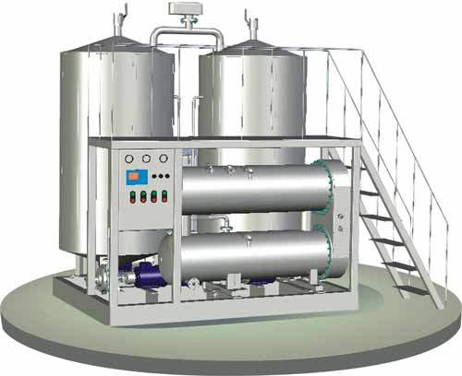
Reacting:
In the presence of a catalyst
Yields:
100 Lbs.
Vegetable Oil
or
Animal Fat
+
10 Lbs.
Alcohol
100 Lbs.
Biodiesel
+
10 Lbs.
Glycerine
Produces mono-alkyl esters – chemically similar to diesel fuel
Notes:
This slide is an overview of how biodiesel is produced. In order to make biodiesel—you start with vegetable oil or animal fat. To that liquid, you add an alcohol (usually methanol, or wood alcohol) and a catalyst (typically sodium hydroxide, which has already been dissolved in methanol) and add a little bit of heat and mixing. A chemical reaction occurs, with the methanol reacting with the oil/fat to make two resulting products: biodiesel (the mono alkyl esters) and a by-product glycerin. For 100 pounds of oil/fat, you need 10 pounds of methanol and this creates 100 pounds of biodiesel and 10 pounds of glycerin. The glycerin and biodiesel are separated and cleaned up to make biodiesel meeting ASTM specifications and crude glycerin. Glycerin is a 3 chain sugar and is much more dense than the biodiesel, so it settles easily and fairly quickly to the bottom of the reaction vessel and is decanted off, or it can be removed by centrifuge.
Glycerin is a thick liquid sugar, similar in texture and taste to Karo Syrup, and is most often purified into refined glycerin and used in a variety of foods, soaps, and cosmetics. Glycerin was even the first anti-freeze. With less expensive petroleum based propylene and ethylene glycol, glycerine use as an antifreeze declined, but recent hikes in crude oil pricing has provided an opportunity for glycerin to re-substitute back into the market as a non-toxic, safe, biodegradable antifreeze.

Slide 7

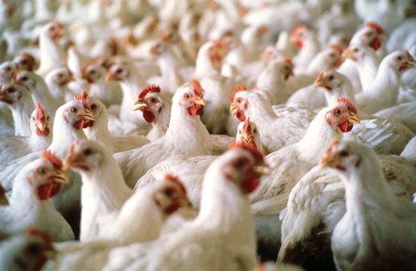
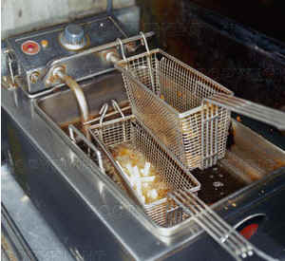
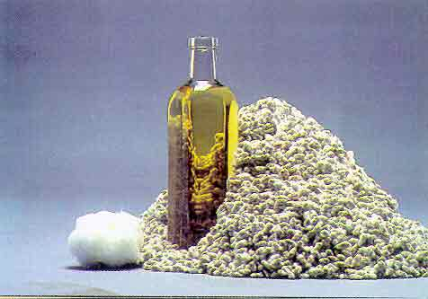
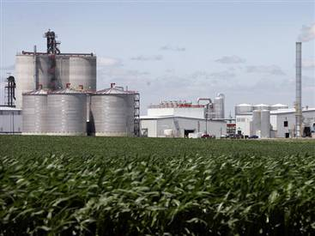

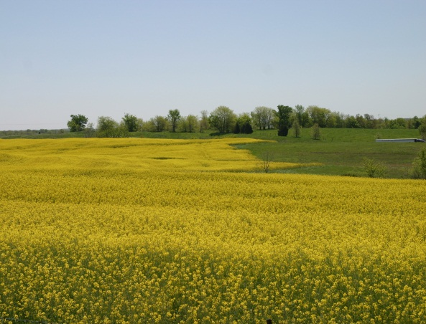

Domestic Feedstocks
Poultry Fats
Beef/Pork Fats
Cottonseed Oil
Yellow Grease
Corn Oil By-Product from Ethanol Plants
Canola Oil
Camelina Oil
Soybean Oil
Notes:
Some of the common oils and fats available in the US as raw materials for biodiesel are listed on this slide. Basically any oil or fat can be used. Soybean oil is the most common oil in the US and is the cheapest vegetable oil, so about 50% of the US biodiesel comes is made with soybean oil. But you can use other edible oils like corn oil, canola, cottonseed of sunflower oil. You can also use animal fats—beef fat, pork lard or chicken fat—some of which is considered edible by humans and some which is not. You can also use other oils/fats considered inedible for humans consumption such as the corn oil by-product from ethanol plants or recycled frying oils from McDonald’s or Burger King, which is commonly called yellow grease. Animal fats, used cooking oils and minor amounts of other edible oils make up the other 50% of oils and fats for biodiesel.
The wide variety of oils and fats for biodiesel production are one of the reasons the industry has grown. Biodiesel is not totally dependent on one crop or one source of oils/fat, and companies can change oils/fats as prices vary or as their customers needs vary. Folks on the coasts see much of their biodiesel coming from locally sourced used frying oils, where the upper Midwest sees a lot of soybean oil and canola oil and the lower Midwest, like Texas, sees a lot of beef/pork fat and cottonseed oil.

Slide 8
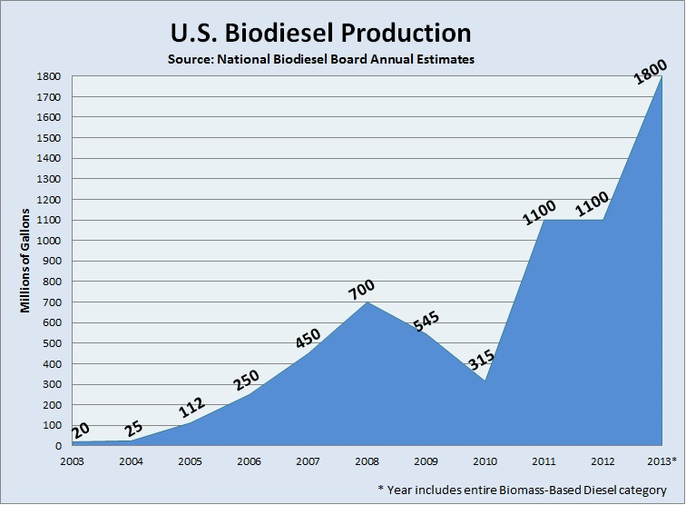
Notes:
So now that you know a little bit about biodiesel and its benefits, the next few slides provide an overview of where the industry is at far as past, present, and future volumes. This chart shows the biodiesel production volumes in the US over the last 10 years. As you can see, just 10 years ago there was very little biodiesel produced in the US, and biodiesel production each of the last three years was over 1 billion gallons per year. Yes, that is billion with a ‘B’. To put that in perspective, in 2013 we used about 40 billion gallons of diesel fuel on the road in the US, and about 60 billion gallons of total distillate fuels (which includes marine, off road, heating oil, etc.).
The biggest factors going into these volumes were the tax incentives and the first Renewable Fuel Standard which started taking affect in 2006-2008, the recession of 2009/2010 which hit all fuel volumes, and then the implementation of the second National Renewable Fuel Standard (RFS-2) in 2011. Biodiesel is a low cost option for refiners to meet the low carbon ‘advanced fuel’ requirements of the Renewable Fuel Standard. This low carbon nature of biodiesel is one of the key factors for biodiesel’s recent—and future—growth.

Slide 9
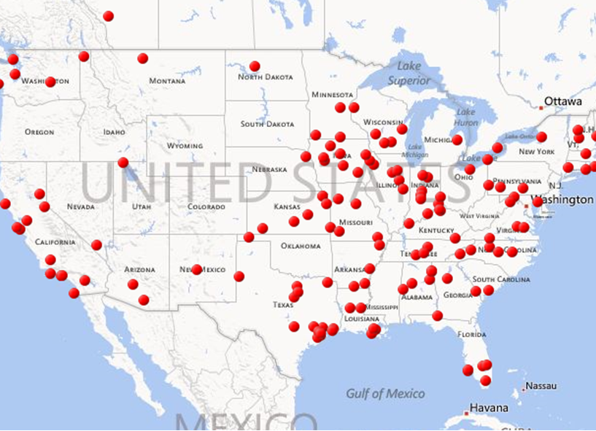
Production Plants Dec 2013
Notes:
Here is a map of the US production plants that produced a total of over 1 billion gallons of B100 in each of the last three years. As you can see, there is biodiesel production in just about every state, and the production plants are much more evenly spread out and distributed than other renewable fuels that are based only on one commodity or feedstock. This is one of the reasons biodiesel enjoys such strong political support—there is a biodiesel manufacturing plant creating high paying, industrial jobs in almost every state. And the support is by-partisan, as both democratic and republican states have reasons to support biodiesel. Even so called ‘big oil’ states like Texas support biodiesel. It may come as a surprise to you that Texas is in the top three biodiesel producing states, largely to the use of beef fat from Texas cattle operation and the preponderance of the chemical industry in the Houston ship channel which is a major source of biodiesel production capacity.
The variety of oils and fats use for biodiesel is the primary reason the plants are so spread out, as each area tends to use the oil or fat that is produced in that region or state since it reduces the transportation costs to get the feedstock oil/fat to the biodiesel plant. Used cooking oils are prevalent on the coasts, soybean oil or animal fats (poultry, hogs, beef) in the Midwest, and beef fat and cottonseed oils in Texas and the south.
The increase in production capacity is important as our population grows, as the US hasn’t built a new petroleum refinery in many years. The biodiesel industry, however, has put in over 200 plants with over 2 billion gallons of annual capacity.

Slide 10
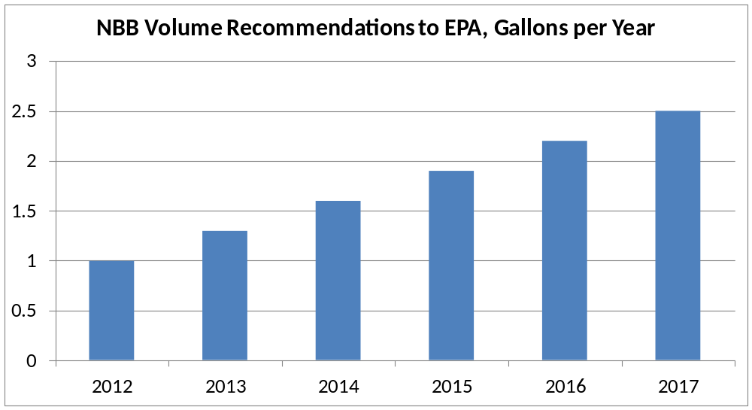
NBB Vision For Future Volumes
NBB members just set a 10 year vision for volume levels of 4 billion gallons per year by 2022
Notes:
As far as future volumes go, this chart shows the volumes that the National Biodiesel Board—as the trade association for the biodiesel industry—is targeting for the next few years and through the year 2022. The industry exceeded the NBB target of 1.3 billion in 2013. NBB is targeting for controlled, manageable growth of around 300 million gallons per year through 2017, when the industry expects to hit 2.5 billion gallons per year.
By 2022, the industry is targeting 4 billion gallons per year, quadrupling the volume target of 1 billion gallons per year in 2012. At the 4 billion gallon per year level of B100, that means the US will need to incorporate B5 in virtually every gallon, and B20 in a bit less than half of the rest of the on-road diesel fuel in the US. It’s an aggressive goal, but the biodiesel industry believes they can hit that target, especially with the new found interest in diesel fuel in light duty applications and the projected strength of diesel in general as more focus is put on fuel economy and on low carbon fuels.

Slide 11


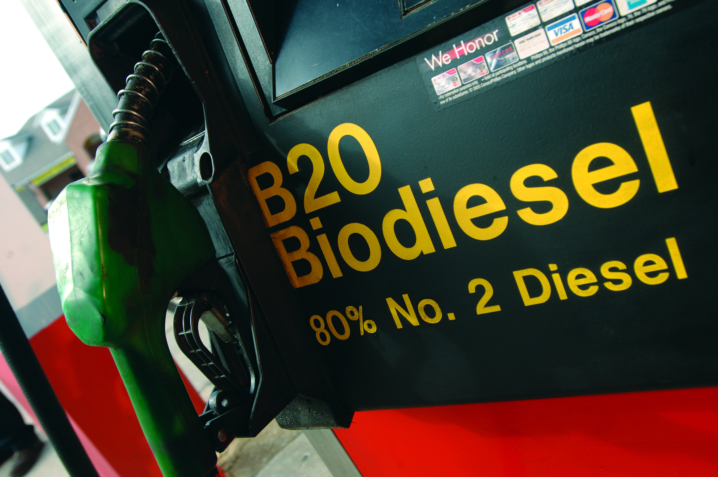
Top Reasons Why Consumers Are Using Biodiesel
Notes:
The next few slides go over the top reasons why consumers are using biodiesel. There have been many ‘new’ fuels that have come and gone and that have never really caught on because there just weren’t enough underlying reasons for consumers to want to purchase the new fuel, or the underlying fundamentals of the fuel changed for some reason. There are many reasons why someone would want to use biodiesel, and that has been a key factor in why biodiesel has grown and why the industry is poised for continued growth into the future.

Slide 12

Biodiesel Improves Diesel Properties
Blends with petrodiesel in any percentage
  Once it is blended it does not separate back out
Higher Cetane
  Over 50 vs. average petrodiesel around 44
  Smoother, more complete burn
Higher Lubricity
  2% biodiesel ‘fixes’ even bad diesel
Virtually Zero Sulfur
  Meets ULSD limits of 15 ppm or less
Zero Aromatics Reduces Toxicity and Burns Cleaner
11% Oxygen Provides Superior Lubricity and Reduces Black Smoke (Particulates)
High Flash Point Makes it Safer
  Non hazardous shipping (over 200 F)
Notes:
So you now know how to make biodiesel, and where it comes from, and here are some of the advantages of biodiesel vs. fossil derived petrodiesel that cause it to be a premium diesel component and why some are using biodiesel. One of the biggest advantages is the biodiesel can be blended in any percentage with diesel fuel and it does not separate back out once blended. This eliminates separation concerns—even in the presence of water.
For those who don’t know, the Cetane Number for diesel fuel is analogous to the octane number for gasoline, with a higher cetane fuel allowing for a smoother and more complete combustion. The average cetane number of US diesel fuel is around 44, with the minimum spec being 40, and the cetane number of pure biodiesel is normally over 50. Many OEMs recommend higher cetane, and customers who use biodiesel blends normally notice a quieter, smoother running engine.
Biodiesel—even in low blends like 2% biodiesel—restores the lubricity lost by removing sulfur to create Ultra Low Sulfur Diesel (ULSD) and this allows refiners and blenders to avoid the added costs of lubricity additives for ULSD which would be needed if biodiesel was not present. Since the vast majority of vegetable oils and animal fats biodiesel is made from have no sulfur, biodiesel naturally is an ultra low sulfur fuel and already meets the EPA required 15 ppm maximum sulfur limit for fuels in the US. This, combined with the high lubricity of biodiesel, makes biodiesel a cost effective way to address the lubricity problems of ULSD.
Similar to sulfur, the oils/fats for biodiesel have no aromatic compounds so finished biodiesel has zero aromatics. Aromatics, i.e. benzenes, xylenes, toluenes, or polycyclics that make up between 20% and 40% of petrodiesel are thought to cause cancer, so the emissions from biodiesel are significantly less toxic and less cancer-causing than conventional diesel fuel. Biodiesel also has 11% oxygen vs. diesel fuel or other hydrocarbons which have no oxygen. Oxygen in biodiesel not only provides the lubricity advantages, it produces a more complete burn and reduces black smoke and particulates that are not possible with hydrocarbon only type fuels. Biodiesel also has a very high flash point, which makes it a much safer fuel than propane, natural gas, or gasoline—or even diesel fuel. It is so safe that B100 falls within the non-hazardous category for shipping and handing.

Slide 13

Biodiesel is Cleaner
Tailpipe emissions in un-modified diesel engines are reduced by running on biodiesel blends in pre-2010 diesel engines (i.e. no major aftertreatment)
B20: NOx is 90% lower in today’s new technology diesel engines compared to engines older than 2010 without aftertreatment systems
Emission Type |  | B20 | B2
Total Unburned Hydrocarbons |  | -20% | -2.2%
Carbon Monoxide |  | -12% | -1.3%
Particulate Matter |  | -12% | -1.3%
Oxides of Nitrogen (NO_{X}) |  | +/-2% | +/-.2%
Notes:
13
First and foremost, one of the top reasons why people using Biodiesel is that it reduces emissions coming out the back of an engine without making any change or modification to the engine other than burning the biodiesel blend. As the chart below shows the emissions impacts in diesel engines pre-2010. Those are engines that do not have after treatment systems like PM traps for reducing particulate matter and SCR systems to reduce NOx.
B20 Blends reduce unburned hydrocarbons by 20%, carbon oxide by 12%, and particular matter by 12% with NOx values going up or down a little depending on the engines and emissions cycle used. With older engines you can tell a definite difference, with a less noxious smell and less visual smoke coming out the back of the engine when running on B20. A lot of school bus companies are utilizing B20 due to these emissions reductions, and mechanics in the shop find that the B20 emissions do not sting their eyes and burn thier lungs as much as petrodiesel.
While B20 and lower blends don’t show much change with NOx, the new diesel engines with SCR NOx reducing systems show over a 90% NOx reduction with B20 compared to the older engines. There is more information on this in the engine and after-treatment section, but most people do not realize that using B20 in a new diesel engine produces 90% less NOx (and PM for that matter) than an older engine, so that really bodes well for the future of biodiesel—and diesel engines in general.

Slide 14

Biodiesel Is Cleaner
Biodiesel Reduces Global Warming
Closed Carbon Cycle: CO₂ Used to Grow Feedstock is Put Back Into Air
    76% Life Cycle Decrease In CO₂
Energy Balance 5.4 to 1
    Over 5 times as much energy out
    as it took to make the biodiesel
Compression Ignition Platform (i.e. diesel) 30% More Efficient Than Spark Ignition (i.e. gasoline, CNG, propane)
Notes:
Another major reason why people are looking to use biodiesel is its positive impact on global warming and climate change. Biodiesel has what we call a closed carbon cycle. The CO2 used to grow the plant or animal is put back into the air when you burn the fuel. The USDA and Department of Energy have completed independent research showing an overall 78% lifecycle decrease in CO2 when using biodiesel compared to petroleum based diesel fuel. That number is getting better every year, as improvements in producing oils and fats and in processing biodiesel occur.
Biodiesel also brings a positive energy balance to the table. The energy balance is a measure of how much energy is derived from the fuel vs. the amount of energy it takes to grow, harvest, and produce the fuel. When one uses biodiesel, you get over 5 times the energy out of the fuel when burned compared to the amount of energy it took to make the biodiesel. This is the highest energy balance of any fuel made in the USA. It’s much better than other fuels because biodiesel is made from oils or fats, which are a by-product of producing oilseed crops or high quality meats. Soybeans, for instance, are 80% high protein meal and only 20% oil so most of the energy of growing and harvesting the crop are attributed to the meal portion, not the oil portion. Beef, pork and poultry are grown for the meat, not for the oil that is rendered from meat processing left overs. The oil portion is also high in energy content, which is why we have a high BTU content fuel.
In addition, when you look at the Compression Ignition Platform, or the diesel platform, that’s about 30% more efficient than the Spark Ignition Platform (i.e. gasoline, CNG or propane). This is why diesel fuel economy is so much better than gasoline, CNG, or propane, and this serves to reduce global warming even further. So when you combine those all together—Closed carbon cycle, positive energy balance, and increased diesel engine efficiency--biodiesel run in an existing diesel engine is one of the most powerful tools available to help mitigate climate change and decrease our impact on global warming.

Slide 15

It’s Here and Now
Biodiesel has over 3 billion gallons/yr of installed capacity in the US.
Biodiesel is America’s first domestically produced, commercially available Advanced Biofuel and meets EPA requirements of 50% life cycle carbon reduction for inclusion and use under the new Renewable Fuels Standard (RFS-2).
RFS-2 mandates 5 billion gallons of Advanced Biofuel from non-cellulosic feedstocks be used by obligated parties (i.e. refiners) by 2022
Notes:
Another important reason people are using Biodiesel is that it's domestically produced in commercial scale billion gallon quantities TODAY. It is classified as an advanced biofuel under the EPA requirements for the Renewable Fuels Standard (RFS) due to that 78% reduction in life cycle carbon emissions. Advanced biofuels are those biofuels that reduce carbon into the atmosphere by over 50% compared to it's petroleum counterpart. Corn based ethanol is not an advanced biofuel, but biodiesel is. To meet the RFS, refiners must incorporate advanced fuels, and with biodiesel being one of the cheapest and easiest, it’s a fuel of choice for refiners to use to meet their obligations—which increase every year through 2022. Biodiesel is one of the most cost-effective options to meet the renewable fuel standard for refiners and that's a major reason why we are seeing increasing levels of biodiesel being made available by refiners.

Slide 16

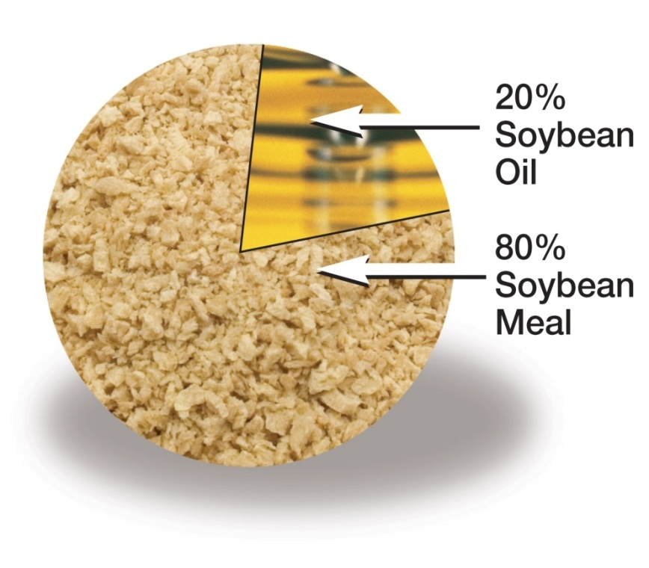
Sustainability
Biodiesel is produced from a variety of renewable resources, such as plant oils, animal fats, recycled grease, and even algae, making it one of the most sustainable fuels on the planet.
With biodiesel, food isn’t sacrificed for fuel. Oils and fats for biodiesel are a minor by-product of producing food for humans and animals.
– Soybeans are 80% protein, 20% oil
– No one grows livestock for its fat content
– No one cooks more fried food to get used oil for biodiesel
Notes:
16
We mentioned that biodiesel is made from the by-product oils and fats from oilseeds, meats, and recycled cooking oils from McDonalds and Burger King. Algal oils can also be used, although algae is not yet commercially viable in large scale at this time. Each of these is a renewable resource that is grown from CO2 in the air and replenished each year, so they are a potential never ending source of fuel. This is opposed to gasoline, diesel, CNG, or propane which are extracted from the earth and once its used its gone forever, with all the CO2 going into the atmosphere vs. remaining sequestered in the ground. This makes biodiesel one of the most sustainable fuels on the planet.
Another major aspect of biodiesel—which many people don’t realize—is that with biodiesel you don’t sacrifice food for fuel. Oils and fats for biodiesel are a minor by-product of producing food. Soybeans are 80% high protein meal that feeds humans and animals and only 20% oil—an only a portion of the oil is used for biodiesel. No one grows soybeans for the oil—soybeans are grown for the 80% protein portion which feeds humans and animals. Beef, hogs, and poultry are certainly not grown for their fat content—they are grown for the steaks, pork chops and chicken legs we all consume every day. And no one at a fast food restaurant fries more french fries to get the used cooking oil for biodiesel.
In addition, by providing a viable outlet for the by-product oils/fats, independent studies have shown this actually reduces the price for the protein portion which makes more food available, not less. By using biodiesel, one is actually encouraging more food production. This has been a major question with some other renewable fuels, but with biodiesel it is an extremely positive impact. This is certainly one of the reasons biodiesel is growing and why the future looks promising.

Slide 17
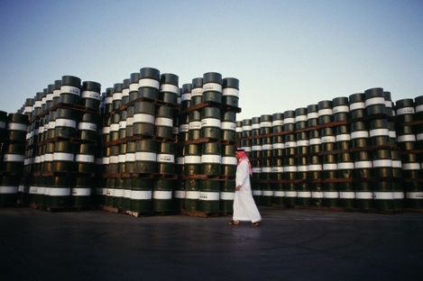
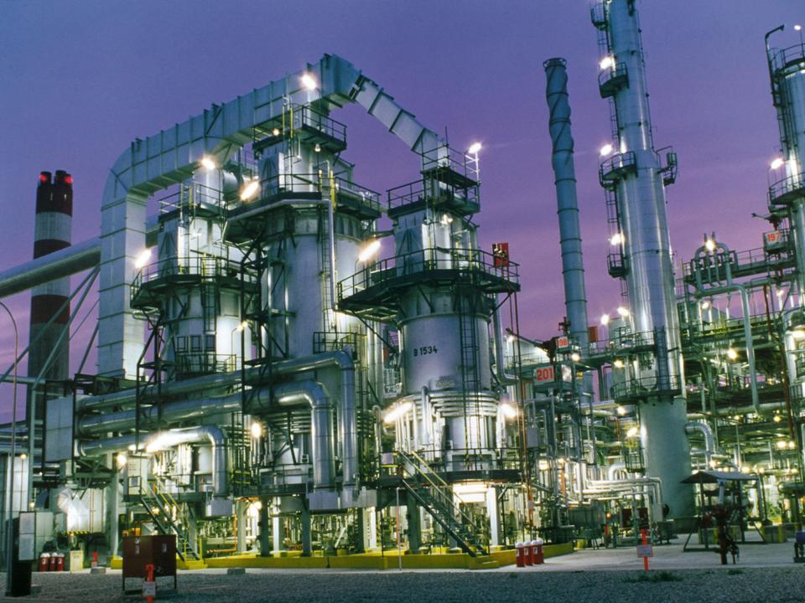
Energy Security & Economy
Reduces our dependence on foreign oil
Expands and diversifies our domestic refinery capacity
Most economical option for turning oils and fats into usable fuel diesel applications
Creates added outlets for farm-based products
Creates U.S. manufacturing jobs
Notes:
Another reason why biodiesel is going in popularity is it's overall impact the energy security and economy. Biodiesel reduces our dependence on foreign oil, which helps improve the US trade balance and lessens the need for us to send troops overseas to protect our access to foreign oil. Biodiesel helps to expand and diversify our domestic refining capacity for making fuels in the US. We have not build a new petroleum refinery in the US and many years, but as our population grows and economy strengthens, we will need more diesel fuel. While commercial in scale, biodiesel operations are smaller and more diverse than petroleum refineries, which enhance energy security as there is no major impact on the biodiesel market if one biodiesel production operation goes down for maintenance or a processing issue—or a natural or man-made disaster. When hurricane Katrina hit the south and knocked out the refineries there, the only diesel fuel that was available in Minnesota for a period of time after that was biodiesel made in the Midwest.
Biodiesel is also the most economical option for turning oils into usable diesel fuel, and as we mentioned earlier it creates a viable outlet for agricultural oils and fats which helps the rural economy produce more food at a lower price. And the biodiesel production facility creates relatively high paying manufacturing jobs---as well as other jobs which support the biodiesel industry like railroads and trucking. These factors are why politicians and governments are encouraging biodiesel and why there are many favorable tax incentives and policies that help support the industry.

Slide 18
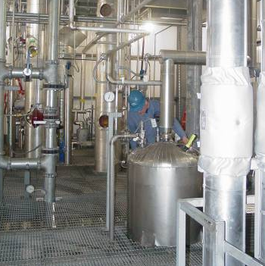

Energy Security & Economy
The 1+ billion gallons of biodiesel produced in 2012 supported more than 64,000 jobs across the U.S. and contributed over $6.08 billion to the GDP
The 4.6 billion gallons of biodiesel produced in the U.S. since 2005 have:
  Displaced 4.6 billion gallons of diesel fuel
  Decreased lifecycle GHG emissions by 56.2 billion pounds
  Equivalent to removing 4.96 million passenger vehicles from America’s roadways
Notes:
This slide goes over some of the details of the impacts of biodiesel on the economy. Again, this is a major reason why you see both federal and state lawmakers putting into place very favorable policies that encourage biodiesel production and use. In 2012 alone, the over 1 billion gallons of biodiesel supported more than 64,000 jobs and contributed over $6 billion to the gross domestic product.
When you look at an even larger picture the 4,6 billion gallons of biodiesel produced in the US since 2005 and displaced 4.6 gallons of diesel fuel and decreased lifecycle greenhouse gas emissions by over 56 billion pounds. That’s the equivalent of removing almost 5 million passenger vehicles from the road in the US.

Slide 19

ASTM Standards for Biodiesel
ASTM D6751 is the approved standard for B100 for blending up to B20, in effect since 2001
  Performance-based standard: Feedstock and Process Neutral
  48 states have now legislatively adopted the ASTM D6751 specifications for biodiesel
D975 – Covers petrodiesel and blends up to 5% biodiesel maximum for on/off road engines since 2008
D7467 – Covers blends containing 6% to 20% biodiesel for on/off road engines since 2008
D396 - Covers heating oil and blends up to 5% biodiesel in boilers and home heating oil units since 2008
19
Notes:
19
Biodiesel production is guided by stringent ASTM fuel specifications, developed through years of testing. Meeting the ASTM specifications is the single most critical factor in trouble-free use of biodiesel blends. Over $100 million have been spent over the last 20 years on research and testing of biodiesel in order to secure the ASTM specifications for biodiesel. The biodiesel industry works closely with OEMs and petroleum companies to identify needed technical information, and continued investment to answer technical questions that arise is something that sets the biodiesel industry apart from other fuels. The ASTM D6751 specifications continue to improve and evolve over time, especially as petrodiesel and engines change. There were significant changes to the biodiesel specifications to adjust to Ultra Low Sulfur Diesel Fuel, and testing is currently occurring to determine if additional changes are needed to accommodate the new aftertreatment systems and the new high pressure common rail fuel systems.
ASTM D6751 is the standard for the pure biodiesel prior to blending. It was first approved in 2001, and has gone through some major improvements as mentioned. The specification was developed in a similar way as the diesel specification, as it is performance based and feedstock and process neutral. This allows maximum flexibility (which help to minimize costs) while still producing a fuel that will perform as expected in an engine. With diesel fuel, it doesn’t matter exactly what the refinery processes are involved or whether the crude oil was North Sea Brent, South African Crude, etc. as long as the fuel meets the D975 diesel spec. The same is true for biodiesel—it doesn’t matter what processes the biodiesel operation uses or which oil/fat is used—as long as the finished biodiesel meets ASTM D6751.
Meeting the specification is absolutely critical, as the major control for biodiesel is at the B100 level prior to blending. At present, 48 states have adopted the D6751 standard as the legal standard for biodiesel, with New Jersey to come soon and no plans for efforts to encourage the last state, Alaska. D975 and D396 are the traditional diesel fuel and home heating oil specifications, and in 2008 they were modified to permit the inclusion of up to 5% biodiesel meeting D6751 into the traditional fuel pool. No changes to the traditional specifications were needed, as most of the physical and chemical properties of B100 meeting D6751 are very similar to petrodiesel. Biodiesel is now just one of the blending stocks that refiners can use to make conventional diesel fuel and heating oil and the fuel at the pump may contain up to 5% biodiesel right now.
B6-B20 blends for on/off road fuel are covered under D7467. The properties are the same as the widest of either #1 or #2 diesel in D975, with the addition of an acid value and stability parameter for the B6-B20 blends. Passage of ASTM specifications was a pre-condition for most OEMs to issue support for B20 in their engines.

Slide 20



BQ-9000 and Fuel Quality
The biodiesel industry has an excellent fuel quality program called BQ-9000 (www.bq-9000.org)
Helps ensure that only the highest-quality biodiesel meeting ASTM specifications gets put into your fuel tanks
ASTM Grade Fuel, BQ-9000 Companies
85% of US biodiesel produced is by BQ-9000 accredited companies.
Notes:
NBB implemented BQ-9000 as a means to help instill confidence in biodiesel with users and equipment companies. The biodiesel industry had some issues with fuel quality early on, and quickly realized that product not meeting the specification WILL eventually show problems in diesel engines over time. This is one of the major issues with use of just raw, unprocessed vegetable oils and why they are NOT biodiesel. And the newer engines, with tighter tolerances and higher temperatures and pressures, are even more sensitive to fuel quality than the older engines. With a developing industry, customers and OEMs wanted a way to know if they were really getting ASTM grade product, and buying from a BQ-9000 accredited company is the best way to insure that—a kind of good housekeeping seal of approval for biodiesel companies.
The BQ-9000 quality program is a certification process for companies that encompasses the complete biodiesel production and distribution process including manufacturing, sampling, testing, blending, storage, shipping and distribution. Its goal is to insure that only ASTM grade product is put into the market. ASTM grade product is made by BQ-9000 companies.
There are now three BQ-9000 designations:
Producer, (i.e. make it to spec)
Marketer (i.e. buy spec, keep it in spec, blend it right)
Certified Laboratories (i.e. test the fuel, run the tests right)
Many customers and OEMs are now either requiring or strongly encouraging BQ-9000. The passage and continuous improvement in the ASTM specifications, the legal adoption of those specifications in just about every state, and the implementation of the BQ-9000 fuel quality program in combination have virtually eliminated the fuel quality issues that were seen in the early days of biodiesel in the USA.

Slide 21

OEM Warranty Statements
All major OEMs selling diesel equipment in the U.S. support at least B5 and lower blends, provided they are made with biodiesel meeting ASTM D 6751
  Most OEMs are also recommending use of a BQ-9000 supplier
Over 75 percent of U.S. manufacturers (39 brands) support B20 or higher blends in at least some of their equipment;
Nearly 90 percent of the medium- and heavy-duty truck markets support B20 in some or all of their equipment
For a complete listing of OEM position statements on biodiesel, as well as the current U.S. Diesel Vehicles List, visit: www.biodiesel.org/using-biodiesel/oem-information
Notes:
Now we're going to get into the OEM warranty statements and where all the engine and vehicle companies are at with their support for biodiesel at the present time.
All major OEM selling diesel engines in the US formally support at least B5 and lower blends provided, of course, the blends are made with ASTM D6751 grade biodiesel. Most of the OEM’s are also recommending the use of a BQ-9000 company or supplier, so that have that added assurance the biodiesel was actually made to specification.
Over 75% of US manufacturers (that 39 brands) support B20 or higher blends in at least some of their equipment, with nearly 90% of the medium and heavy-duty truck markets supporting B20. The medium and heavy-duty sector is where the most of the effort by NBB has been placed, as that is where the majority of the diesel feel is used.
A complete listing of each company and the specifics of their position can be found on the NBB web site.

Slide 22
























OEMs Supporting B20

Slide 23











OEMs Supporting B20
*
*
*
*
*Models equipped with Cummins engines are B20 approved. See NBB website for details.

Slide 24


New in 2012: Volvo Trucks & Mack Support B20
Volvo & Mack B20 warranty statements:
“Use of biodiesel up to a maximum of 20% (B20) in and of itself, will not affect the manufacturer's mechanical warranty as to engine and emissions system related components, provided the bio fuel used in the blend conforms to ASTM D6751, B1 to B5 blends conform to ASTM D975, and B6 to B20 blends conform to ASTM D7467.
Engine and aftertreatment emissions system component warranties are valid providing the B20 blend meets the respective ASTM standard. Customers will need to utilize oil sampling to establish appropriate drain interval(s) for their specific application(s).”
Notes:
This is a sample of the specific owners manual wording issued by Volvo and Mack in 2012. It is pretty typical of the wording used by most other OEMs.
It states that use of B20—in and of itself—will not void their parts and workmanship warranty if the fuel meets specification.
Its important to realize that for both diesel fuel and for biodiesel blends, problems actually caused by the fuel are the responsibility of the fuel supplier, not the engine or vehicle OEM. If a diesel fuel has water or salt or in-appropriate cold flow properties and the fuel caused a problem, that problem is not covered by the OEM parts and workmanship warranty. OEMs warrant the parts and workmanship of the vehicles they sell, not the fuel used in the vehicle.
The same is true with use of biodiesel blends higher than that recommended by the manufacturer. Use of biodiesel—even up to B100—does not in and of itself void and OEM parts and workmanship warranty. But, if there is a problem specifically caused by use of blend levels higher than that recommended by the OEM, then that problem would not be covered by the OEM—it would be the responsibility of the user or the fuel supplier. Many users currently burn blends higher than are formally recommended by their OEM with great success, but if there are problems that are specifically caused by use of higher blends, such as hose or gasket incompatibility or engine oil dilution with fuel—those issues would not be covered by the manufacturers warranty.
High quality, ASTM grade B20 has been used successfully in just about every make and model out there, so the specifications have been largely successful in preventing problems regardless of whether the OEM formally supports B20. The NBB is working cooperatively with the OEM community to encourage all OEM’s to formally support B20.

Slide 25
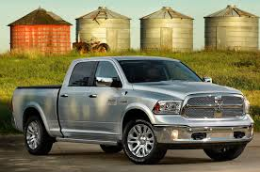





B20 Approved – Updates
Chrysler supports the use of B20 in the 6.7L Ram 2500/3500 pickup and in its all new 2015 Ram 1500 light duty diesel pickup
2015 Ram ProMaster with 3.0L EcoDiesel 14 Engine Approved for B20
New 2015 diesel Jeep Grand Cherokee Approved for B20
Notes:
This is a good example of what the US OEM’s are doing as they are rolling out new diesel models. Chrysler has put B20 into their design plans, so the new diesel models from Chrysler like the 1500 Ram Pickup, the Jeep Grand Cherokee and the new Ram ProMaster Van are formally approved for B20.

Slide 26


2015
Chevrolet Cruze
Approved for use with B20
First light-duty diesel passenger car approved for use with B20 nationwide in U.S.
Notes:
The passenger car diesel market in the US has been largely non-existent since the failed introduction of the Oldsmobile diesel many years ago. But with new high pressure common rail systems with ULSD and after-treatment—which provide a very quiet running vehicle with great acceleration and emissions as low as natural gas vehicles—US customers seem ready to try passenger diesel’s again. Higher fuel costs are also driving customers to diesel due to the increase fuel economy of diesel cars, which are also a benefit for the OEM’s who must increase their corporate average fuel economy (CAFÉ) for all the vehicles they sell. Light duty diesel is a leading avenue for OEMs to meet their CAFÉ standards, and light duty diesel passenger vehicles are expected to see increased market share moving forward.
The new diesel Chevy Cruze is a great example. Over 40 mpg with a relatively inexpensive car—fully approved for B20.

Slide 27

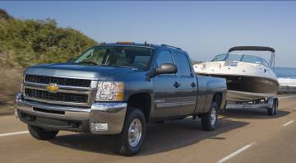
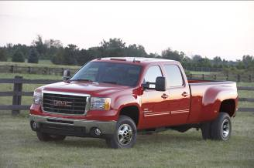


All 2011 MY and beyond GM Heavy Duty Products continue to be approved for B20, and…
Chevrolet Silverado
GMC Sierra
Chevrolet Express
GMC Savana
Notes:
Read Slide as shown

Slide 28

New for 2016:
B20 Approved
B20 Approved
Notes:
Its really encouraging for the biodiesel industry that the leading OEMs have all committed to B20 in all their diesel offerings from here on out. We are even seeing more half ton pickups with diesel models such as the new 2016 Chevy Colorado and the GMC Canyon models.

Slide 29




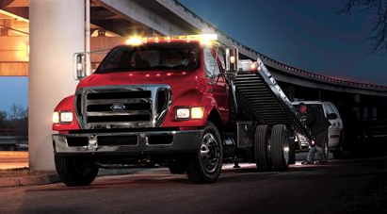
B20 Approved – Updates
Ford approves B20 in all its 2011 MY and beyond
Class 2 - 5 Super Duty &
Class 6,7 Medium Duty Trucks
And in the 2015 Ford Transit Van
Notes:
Last but not least is Ford, who approves B20 in all of its 2011 MY and later model pickups and vans with a diesel engine. For even places a B20 logo on the side of every pickup.

Slide 30

Mike Rowe – Ford B20 Video
Click photo or link in presentation mode to watch video!
Notes:
The culmination of the many years of research, testing, and improvements to the specifications resulted in the following one minute video by Ford spokesperson and Dirty Jobs TV star Mike Rowe. Show Video.

Slide 31
OEM Warranty Status: B20
Arctic Cat (2006)
Buhler (2007)
Caterpillar (All model years)
Chrysler–Ram (2007) & Jeep (2013)
Cummins (2002)
Detroit Diesel (2012)
Freightliner Custom Chassis (2012)
Thomas Built Buses (2012)
Western Star (2012)*
Frightliner (2012)*
Peterbilt (2012)*
Kenworth (2012)*
Ferris (2011)
Ford (2011)
GMC & Chevrolet (2011 all; SEO available since 2007)
HDT USA Motorcycles (2008)
Hino Trucks (2011)
Navistar- International/MaxxForce (2007)
IC Bus (2007)
Isuzu Commercial Trucks (2011)
John Deere (2004)
Kubota (2006)
Mack (EPA2007 & EPA 2010 models)
Monaco RV (2007)
Perkins (2008)
Tomcar (2008)
Toro (2008; SEO kits for <2008)
Volvo Trucks (EPA 2010 models)
Workhorse (2007)
Yanmar (2011)
*with Cummins Engines
Notes:
On these two slides we have placed each manufacturer and when they issued their support for various biodiesel blends. You can see that some OEM’s came on board very early, such as Caterpillar for all models, Cummins in 2002 and John Deere in 2004, while some came on board in 2006-8 after their introduction of PM traps and others in 2010-2012 after SCR aftertreatment. The major factor here is mainly how much time and effort the company put in to understanding biodiesel and confirming to themselves it will work in their engine.

Slide 32
OEM Warranty Status
B100 Support:
CaseIH (2007)
Deutz AG (2012)
Fairbanks Morse (2007)
New Holland (2007)
B5 Support:
Audi (Allow up to B20 in IL/MN in 2009 – 2015 models)
BMW
Hustler Turf Equipment
Mercedes Benz (See brochure for blends over B5)
Mitsubishi Fuso
Volkswagen (Allow up to B20 in IL/MN in 2009-2015 models)
PACCAR Including: Kenworth/Peterbilt w/ Paccar Engines
Notes:
There are some companies that support B100. These companies use mainly Viton type seals and gaskets that are B100 compatible. As mentioned earlier, NBB is working with the B5 OEMs to get them to B20, most of which are from Europe.
Of note is the fact that while both VW and Mercedes only formally support blends up to B5 in the US, they have both informed their customers in Illinois that blends up to B20 can be used in Illinois. There is a tax incentive for biodiesel in Illinois which makes B20 sell at a lower price than diesel much of the time and they had many customers who were asking about blends over B5.

Slide 33

Biodiesel Resources
www.biodiesel.org
  Biodiesel Training Toolkit
  News Releases & Information Resources
  Technical Library, Spec Sheets & Videos
  OEM Warranty Positions on Biodiesel
  U.S. Diesel Vehicle List
www.BQ-9000.org
  Listing of BQ-9000 Certified Companies
www.biotrucker.com
  Listing of BioTrucker retail sites
Notes:
That closes off this session. We want to thank you for attending. This last slide here goes over some resources that are available to you on the web that you can refer to later if you are interested in learning more or if you have a question come up you need answers to.

Slide 34

Thank You!
Questions…?
Steve Howell
NBB Senior Technical Advisor
showell@marciv.com
Call NBB at 1-800-841-5849
Visit www.biodiesel.org

