Slide 1


Biodiesel Technical Training Course
BIO 2.0
Biodiesel Fuel Quality & BQ-9000
Notes:
Welcome to the second installment of the NBB’s ASE accredited Biodiesel for Diesel Technicians Training Program
This hour long course will cover biodiesel fuel quality and the BQ-9000 program.

Slide 2
Learning Objectives
Provide instruction on biodiesel fuel properties
Provide instruction on how these properties affect fuel quality and fuel filtration
Provide information on the BQ-9000 program
Provide background on biodiesel fuel attributes
Notes:
Read slide as seen.

Slide 3
Learning Outcomes
Be able to identify key ASTM biodiesel fuel quality parameters
Be able to describe how these properties affect fuel quality and fuel filtration
Be able to explain the importance of biodiesel fuel quality and the BQ-9000 program
Be able to discern issues between normal diesel problems and poor quality biodiesel imposters or out-of-spec biodiesel when they hit the shop
Notes:
At the end of today’s fuel quality session of Biodiesel for Diesel Technicians, you will be able to answer general questions about biodiesel that you may be asked as a diesel technician, you will understand why customers might want biodiesel vs. conventional diesel fuel or other alternative fuels, you will understand the importance of fuel quality and the BQ9000 quality program, and you’ll also be able to better discern between issues of normal diesel problems and poor quality biodiesel imposters or out of spec biodiesel when they hit your shop. There’s been a tremendous amount of research and technical information on biodiesel over the last 15 years, and this 3-hour session will help you to understand at least a portion of all that research that has gone into making this fuel what it is today.

Slide 4
Transesterification
(the biodiesel reaction)
Methanol
Biodiesel
Triglyceride
Fatty Acid Chain
Glycerol
Notes:
Here is a simple depiction of what happens on a molecular structure with biodiesel. This becomes important when you compare it to how diesel fuel is made and what the biodiesel molecule looks like compared to a diesel molecule. We take the tryglyceride, or the oil or fat, which has a glycerin connected to three of the fatty acid chains. You react that with three parts of methanol. The methanol comes in and attaches itself to each one of those straight-chain fatty acids, and takes the place of glycerin. So you end up with three biodiesel molecules (the methanol actually becomes chemically attached to the fatty acid chain as part of the ‘methyl ester’ group at one end of each biodiesel molecule), and one molecule of glycerin. That is essentially the biodiesel reaction in a nutshell.
The fatty acid part of the molecule is a long, straight chain hydrocarbon that looks very similar to what is found in diesel fuel. The length of the hydrocarbon chain is determined by the particular oil or fat you begin with and is not changed by the biodiesel reaction. Mother nature makes most the natural tri-glycerides with only 4 or 5 different carbon chains containing 16 to 18 carbons. This makes a biodiesel that is high in BTU content and in a similar boiling range and viscosity (or thickness) as petrodiesel. The boiling range and viscosity are the two reasons why one must turn the oil or fat into biodiesel, as the viscosity for the larger oil/fat triglyceride is 10 times higher than diesel or biodiesel and can cause injector fouling over time.
When you start to hear about oils or fats “going bad” is it because there is a premature separation of the fatty acids from the triglyceride molecule (usually from heat or harsh conditions). The fatty acids can cause problems in the reaction, or in the finished fuel, so if any substantial amount is present they are removed in processing. This removal is one of the key steps to using used or degraded cooking oils that you don’t normally need to do with first use oils.

Slide 5
Biodiesel, n. -- a fuel comprised of mono-alkyl esters of long chain fatty acids derived from vegetable oils or animal fats, designated B100, and meeting the requirements of ASTM D 6751.
Biodiesel Blend, n. -- a blend of biodiesel fuel with petroleum-based diesel fuel designated BXX, where XX is the volume percent of biodiesel.
This tight definition was needed in order to secure vehicle, engine and fuel injection equipment company support for biodiesel, as well as to secure ASTM specs
Notes:
Read slide as seen. This is the legal definition that the IRS and EPA use. The reason this definition written in such a way to eliminate raw vegetable oils, non-processed or partly processed oils, mixtures of alcohol and raw vegetable oils blended in diesel fuel, and others. Engine testing has shown that the use of raw vegetable oils and blends of raw vegetable oils causes engine damage. If the fuel does not meet this definition and ASTM D6751 it is not biodiesel and cannot be legally claimed as biodiesel.
Support for biodiesel by the OEM’s is all based on biodiesel that meets or exceeds the ASTM standards.

Slide 6


ASTM Role in the U.S.
ASTM standards meet the needs of Government
  Over 3,300 ASTM standards are cited in the U.S. Code of Federal Regulations (number one cited Standards Development Organization)
ASTM standards are specified in a variety of state and federal laws, tax regulations, product listings (tanks, pumps, dispensers, etc.), safety and OSHA regulations, EPA regulations, insurance listings, and other approvals
ASTM has a rigorous consensus balloting system where one negative vote can fail a standard
  Top folks from petroleum and engine companies all vote on the ASTM standards
  It is the most rigorous fuel standard in the world
The United States will continue to use ASTM standards for fuels
Notes:
ASTM International, previously the American Society for Testing and Materials, is the consensus fuel standards setting body used in the US. ASTM has standards for everything from crayons to piping to fuels and lubricants, and these standards are commonly used by various governmental agencies and regulatory groups. In the case of diesel fuels and biodiesel, ASTM standards are used for taxing the fuel, equipment and OSHA listings, EPA emissions regulations, fire safety codes and other approvals.
The ASTM process is not for the faint at heart. The petroleum and engine companies send their very best engineers and scientists to participate in the voting at ASTM, and one negative vote can kill a ballot for a new standard.
ASTM standards are absolutely key, however, to secure engine and vehicle company approvals for the fuel. The biodiesel industry began the ASTM process in 1993, and efforts at ASTM continue to this day. Doing the research and testing to secure an ASTM standard has been a real key to ensuring trouble-free use of biodiesel, and many people do not realize that the biodiesel industry has been hard at work on ASTM standards for over 20 years. Without this effort, the fuel certainly would not be growing like it is, or have the support of most of the engine and vehicle companies.

Slide 7
ASTM Specifications & Technical Credibility
Biodiesel production is guided by stringent ASTM fuel specifications, developed through years of testing.
The biodiesel industry works closely with OEMs and Petroleum companies to identify needed technical information
  Brainstorming and prioritization each year
Over $100MM in testing and R&D over last 20 years, primarily sponsored by soybean farmers
Continued investment to answer technical questions that arise is something that sets the biodiesel industry apart from other new fuels
ASTM specs are continually being evaluated & improved
Notes:
One thing that sets the biodiesel industry apart from other new fuels, is that they have been willing to invest the time, money, and effort to secure ASTM standards and answer the technical questions that are raised by the leading engineer from the largest companies in the world. ASTM has the reputation of taking a long time to secure a standard. Its not because the ASTM voting process is slow. Voting is done largely electronically now, and occurs rapidly. The part that takes time is the research needed to answer a question that was brought up in a persuasive negative vote. For a concern to be voted non-persuasive, a 2/3 super majority of the voter must vote to over-ride a concern of a negative voter. That’s a pretty tall task.
Lets give an example. The first biodiesel specification passed in 2001, 8 years after work began, did not have a stability requirement and had an acid value requirement of 0.8 mg KOH/gram maximum. When voting on the new B20 standard for finished fuels, one OEM and one petroleum company voted negative, as they believed the acid number needed to be lower for B100 and a stability parameter added to B100 before passing the B20 blended fuel standards. The effort to over-ride those negatives was not successful, and it took several years to do the research needed to determine the right test to use for stability and then to determine what the value should be. That is the part that takes time. Each time someone brings up a valid concern, its another couple of years of testing, costing another $500,000 to $2,000,000.
Once you get through and have an ASTM standard, however, you know you really have something you can hand your hat on.

Slide 8
ASTM Standards for Biodiesel
ASTM D6751 is the approved standard for B100 for blending up to B20, in effect since 2001
  Performance-based standard: Feedstock and Process Neutral
  48 states have now legislatively adopted the ASTM D6751 specifications for biodiesel
D975 – Covers petrodiesel and blends up to 5% biodiesel maximum for on/off road engines since 2008
D7467 – Covers blends containing 6% to 20% biodiesel for on/off road engines since 2008
D396 - Covers heating oil and blends up to 5% biodiesel for boilers and home heating oil units since 2008
8
Notes:
8
There are four key ASTM specifications that outline the requirements to meet these standards.
Read each standard and what is covers.
Biodiesel production is guided by stringent ASTM fuel specifications, developed through years of testing.
The biodiesel industry works closely with OEMs and Petroleum companies to identify needed technical information
Continued investment to answer technical questions that arise is something that sets the biodiesel industry apart from other fuels
The ASTM D6751 specifications continue to improve and evolve over time
Especially as petrodiesel and engines change

Slide 9
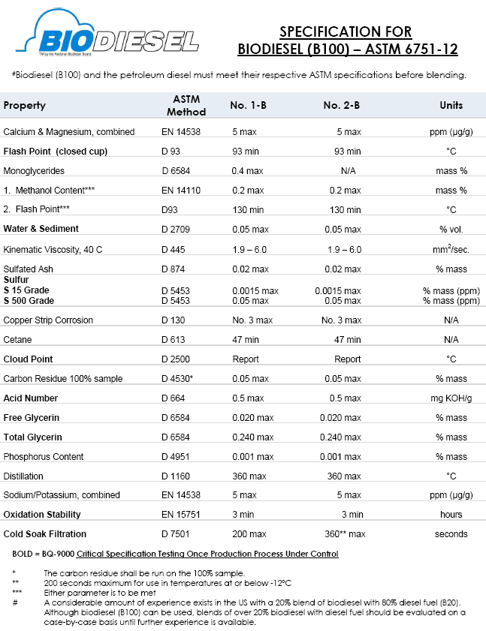
ASTM D6751 Specification
Notes:
This is a summary of the latest ASTM D 6751 fuel specification for biodiesel to be used as a blending stock up to B20. The full ASTM standard can be purchased from ASTM for a nominal fee at www.astm.org.
The standard for B100 was set up to insure the B100 has properties that give a good diesel fuel, to insure the reaction has gone to completion and there is essentially no un-reacted oil/fat, that all the glycerin is removed, and to also insure it doesn’t have minor components that could be found in biodiesel that aren’t normally found or controlled in petrodiesel but that could cause an un-expected problem. It was modeled after D975, as D975 contains the properties important for diesel fuel produced from crude oils like viscosity, flash point, distillation temperature, water/sediment, etc. D6751 contains essentially all the same properties as D975 and then added some that are specific only to biodiesel.
A couple of things to point out here. Biodiesel has separate controls for Calcium/Magnesium, Sodium/Potassium, and Phosphorous. These are metals which could remain in the biodiesel coming from plant oils, wash water or from catalysts, so their removal is controlled by the specification. The flash point of biodiesel is much higher (i.e. safer) than diesel, and a high enough flash point can also be used to make sure any excess methanol has also been removed. While petrodiesel does not have a stability or acid number specification, there are stability and acid number specifications for B100. Total and free glycerin make sure the reaction has gone as planned, and the cold soak filtration test was added in 2011 to address minor compounds which were clogging filters un-expectedly with the new ULSD.
This is the fuel specification each producer must meet to legal definition of biodiesel and the requirements for RFS2 and various tax incentives that are available.

Slide 10
Critical Quality Specifications
Test Criteria | Specification | Why it’s important
Free Glycerin | Max 0.020% mass | Injector coking
Total Glycerin | Max 0.240% mass | Injector coking, filter plugging
Flash Point [Methanol] | Min 130 °C [Max 0.2% methanol] | Shipping/handling safety, injector life
Acid Number | Max 0.50 mg KOH/g | Long term storage, fuel system fouling
Water & Sediment | Max 0.050% volume | Fuel system contamination
Visual Appearance | Max 2 | Indicates moisture or impurities
Oxidative Stability | Min 3.0 hr | Long term storage, fuel filter clogging
Sulfur | Max 15 ppm | EPA regulated specification
Cold Soak Filtration | Max 200/360 sec (summer/winter) | Filter plugging, control minor components
Cloud Point | Report °C | Cold weather storage /handling
10
Notes:
10
10
These are the most critical fuel quality components in the ASTM D 6751 fuel specification. This slide details what they are as well as what the outcome in vehicle operation will be if they are not properly met.
Each of these parameters has its own ASTM test procedure and describes which its important how the specification protects the consumer of the fuel.
Again, these specifications are in place to insure biodiesel, from any feedstock, will work properly in a compression-ignition engine. The production process needs to meet these major objectives:
Complete Reaction/Removal of Glycerin – Insured through total/free glycerin spec
Removal of Catalyst – Insured through sulfated ash spec and Na/K spec.
Removal of Alcohol – Insured through flash point/methanol spec
Absence of Free Fatty Acids – Insured through acid value spec
Absence of problematic minor components – Insured through the cold soak filtration spec

Slide 11
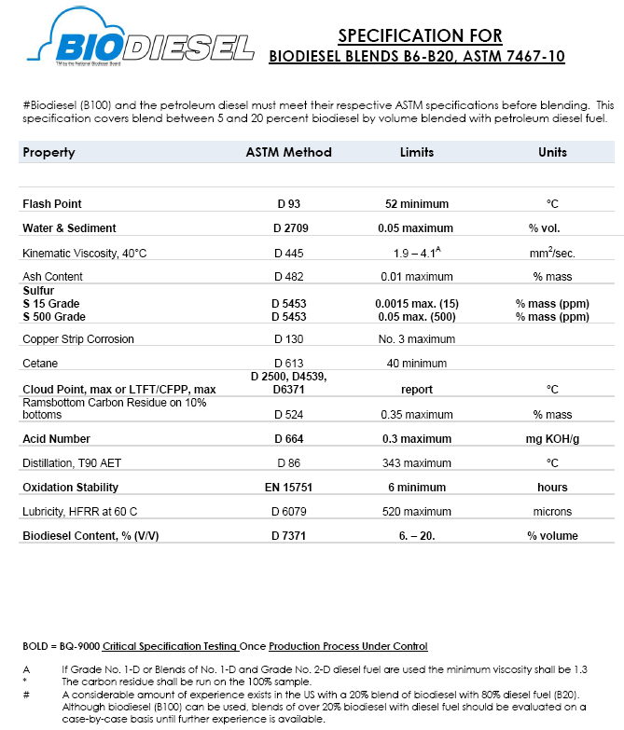
ASTM D7467 Specification
Notes:
The is the biodiesel specification for B6 to B20. The property list is the same as that of petrodiesel (i.e. D975), and the values are exactly the same as the widest of either the #1 or #2 grade of fuel in D975 since either grade can be used in diesel engines. The B6-B20 spec actually covers from B5.5 to B20.5 with rounding.
The only difference between this and D975 (i.e. normal diesel fuel) are the addition of acid number of 0.3 mg KOH/gram maximum for the finished blend and a minimum stability for the blend of 6 hours. These parameters were added as additional assurances the fuel would be stable for a minimum of 6 months and so that users could take a sample of the finished fuel and determine if it still had adequate stability. The only other change from D975 is the allowance for a slightly higher T90 distillation temperature if the fuel contained biodiesel.
The B6-B20 specifications were set up in such a way that the blended fuel will always meet its specification as long as the biodiesel and diesel fuel met their respective specifications prior to blending. So one should not need to sample and analyze the B20 after it is blended as long as the parent fuels making the blend are good, but one could take a sample to analyze it for the B6-B20 specification further downstream as a convenient check if they wished.

Slide 12



Biodiesel Quality Assurance
Quality Assurance is the backbone of not just building an industry but also maintaining its existence.
Biodiesel will continue to grow due to its premium properties and other benefits which have made their way into many beneficial policies and regulations.
With this growth also comes great responsibility to maintain quality. In the Biodiesel industry this is accomplished through BQ-9000 and hard work at ASTM
Notes:
Read Slide as is

Slide 13



What is BQ-9000
Biodiesel Industry’s equivalent to an ISO 9000 program for biodiesel production & distribution companies as well as testing labs
NBB implemented BQ-9000 as a means to help instill confidence in biodiesel with users and equipment companies
There are three BQ-9000 designations:
  Producer (make it to spec)
  Marketer (buy spec, keep it in spec, blend it right)
  Certified Laboratories (test the fuel, run the tests right)
Approximately 85% of biodiesel produced in the US is by BQ-9000 accredited companies.
Many OEMs are now either requiring or strongly encouraging BQ-9000
Organizations have seen economic advantages as more bids are requiring the certification
Notes:
13
13
BQ-9000 works hand-in-hand with the ASTM specifications for biodiesel
Quality Control System covers biodiesel manufacturing, sampling, testing, blending, storage, shipping, distribution
ASTM Grade Fuel, BQ-9000 Companies

Slide 14
National Biodiesel Accreditation Commission (NBAC)
The Commission is comprised of 12 Commissioners representing the interests of producers, marketers, laboratories, feedstock suppliers, and consumers.
Commissioners are responsible for the review and approval of the audits as well as improvements and modifications of each of the programs
Accredited companies are audited on an annual basis. Each of the 7 auditors maintains a 3 year audit cycle rotation with each of their assigned companies.
The NBAC is currently Chaired by the Vice President of the Truck and Engine Manufacturers Association, Mr. Roger Gault.
Notes:
Read as-is

Slide 15
New Upcoming Category
OEMs have been requesting a BQ-9000 Retailer Program for their customers.
OEMs have stated that a BQ-9000 Retailer Program would provide more confidence for blends greater than B5.
The NBAC is currently in the progress of drafting the program requirements for Retailer Accreditation.
Notes:
Read as-is

Slide 16


BQ-9000 Companies
As of March 1, 2014; there are currently 50 accredited Producers approved within the program, however these 50 producers make about 85% of all the biodiesel in the US.
There are also 25 accredited Marketers / Blenders
Additionally, there are 13 accredited Labs
The NBAC is currently working on a new Program for BQ-9000 Retailers. Additional information may be found at www.bq9000.org
Notes:
Read slide as-is.

Slide 17
BQ-9000 Quality – National Efforts
Notes:
This slide shows the progress of the industry on the BQ-9000 program since it was implemented. It took a little while to catch on, but the industry is now to the point where over 85% of biodiesel produced and shipped to market is by BQ-9000 accredited companies.

Slide 18
2013 NREL Fuel Quality Survey
Over 87% of biodiesel in the market produced by BQ-9000 approved companies
Samples from 53 producers and 14 terminals were collected. Critical properties were tested (free/total glycerin, metals, oxidation stability, acid value, etc.)
More than 95% of all the samples collected met the specification limits
Meeting today’s D6751 eliminates issues seen with some biodiesel in the past
Notes:
The biodiesel industry’s attention to quality has made a big difference. The National Renewable Energy laboratory does a periodic third party, independent survey of biodiesel and biodiesel blend quality. Early fuel quality levels were found to be as low as only 50% of the product meeting the ASTM specifications. For the latest survey, done in 2013, over 95% of the fuel in the market place from 53 producers and 14 terminals met the latest ASTM specifications. The BQ-9000 program and the fuel quality efforts by the biodiesel industry have made a real difference.
When you combine this in-spec level of fuel, with the improved specification that have been implemented at ASTM, the biodiesel being used today has virtually eliminated the issues with some biodiesel in the past.

Slide 19
Energy Content
Not specified by ASTM for diesel (or biodiesel)
Typically expressed as BTUs/gallon
B100 has BTU/gallon similar to #1 US diesel fuel
      3-9% less than average US #2 diesel fuel
B20 has 0.5 to 2% less BTU than average US #2
Most users cannot tell the difference in B20 fuel economy or power
    Some see improvement in fuel economy
    Most like due to cleaning the fuel system
Notes:
Energy content of a fuel is typically expressed in BTU/gallon. The energy content of B100, or pure biodiesel, is similar to US #1 diesel fuel or about 3-9% less than average US #2 petroleum diesel. At the B20 level most users cannot discern any difference in fuel economy or power.
In some cases, there are those who have documented significantly better fuel economy with B20. The fuel economy should be similar or maybe slightly less with B20, so it is believed the fuel economy improvements observed in these cases is likely a cleaning effect of the fuel on the fuel system and injectors—similar to a detergent additive—rather than any impact based on energy content of the fuel.

Slide 20
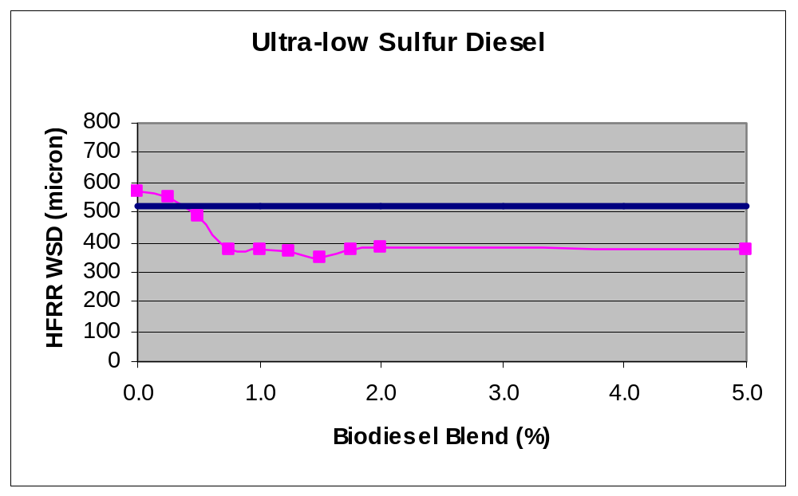
Enhanced Lubricity
Equipment benefits
  Superior lubricity
  B2 has up to 66% more lubricity than #2 Diesel
EPA required sulfur reduction in diesel in 2006
No overdosing concerns vs. other lubricity additives
Notes:
20
Here you see the chart on lubricity. The diesel equipment companies recommend that the lubricity using this HFRR (high frequency reciprocating rig) test should be below 450. So the wear scar when this test is run should be a low wear scar, which is a good thing. The actual ASTM spec for that, which was recently set, is actually at 520. This chart shows that, as you add more biodiesel, you significantly increase the lubricity from a value of 575 to below 400 with a little less than 1% biodiesel. An interesting phenomenon is that if you add more biodiesel, you don’t get any additional lubricity benefits. So biodiesel has the property whereby just adding small amounts of biodiesel can provide the lubricity you need. In this case, 2% biodiesel had 66% more lubricity than the No. 2 fuel. This No. 2 fuel would be out of spec with today’s diesel fuel spec. So even in low concentrations, biodiesel can bring back the lubricity of fuel. One of the great attributes of biodiesel is that since it is a fuel itself, not an additive, if you add more biodiesel you’re not concerned about overdosing issues. Whereas if you use a lubricity additive there is the possibility of overdosing and causing injector problems to happen. You could potentially create a problem by solving a different one. But with biodiesel, that is not an issue. You won’t get any more lubricity benefit, but you won’t have any overdosing issues either. So biodiesel has some significant physical and chemical property benefits compared to conventional diesel fuel, so that is one reason why people are interested in biodiesel.

Slide 21

Low temperature Operation
Cloud Point, Low Temperature Flow Test, and Pour Point are used to monitor a fuels operability in cold conditions.
Cloud Point is the measurement of the temperature in which wax crystals begin to form.
Cold Filter Plug Point, gives and indication of the temperature a fuel will plug a filter.
Pour Point, the temperature when a fuel will still flow, but will not be operable in an engine.
Cold weather can cloud and even gel any diesel fuel, including biodiesel.
Users of a B20 with #2 diesel will usually experience an increase of the cold flow properties (cold filter plugging point, cloud point, pour point) approximately 2 to 10° Fahrenheit.
B20 has been used successfully in climates below -20ºF
Notes:
Read the slide as is.
Additional information has been documented on biodiesel’s use in cold weather. Of course, cold weather we know can cloud and gel any diesel fuel, including biodiesel, and users with B20 with No. 2 usually see a slight increase of the cold flow properties, with the fuel starting to gel about 2-10 degrees F faster than with #2.
The key factor here is what the cold flow property of the finished blend is, not what the parent fuels are. The cold flow values for petrodiesel can vary from 20 F to as low as -50F, so there is quite a bit of variability in conventional diesel. Over the last several years, the petroleum blenders have figured out the cheapest and easiest way to insure biodiesel blends won’t gel up—similar to how they learned to deal with #2 gelling many years ago. Similar precautions can be employed for biodiesel blends that are used for petroleum diesel, i.e. selection of the right diesel and biodiesel base stocks for the appropriate time of year, blends with No. 1 fuel, use fuel heaters or parking indoors, or use a cold flow improvement additive.

Slide 22
Cold-Weather Performance
Last winter, 2013, was the highest volume of biodiesel on record:
  B20 was up to 20 cents cheaper than diesel in some areas
  Cold flow problems with B20 and lower blends were at the same level—if not lower—than petrodiesel
  New specs, emphasis on meeting the specs, is paying off!
Your supplier should deliver a B20 blend that works for your climate and the time of year. Work with your supplier to make sure the biodiesel blend cloud point is adequate for your climate and the time of year the fuel will actually be used.
Similar precautions employed for petrodiesel are needed for B20 and lower blends:
  Blending with #1 diesel / #1 biodiesel
  Using fuel heaters and parking indoors
  Using a cold-flow additive
Notes:
Read as is.

Slide 23
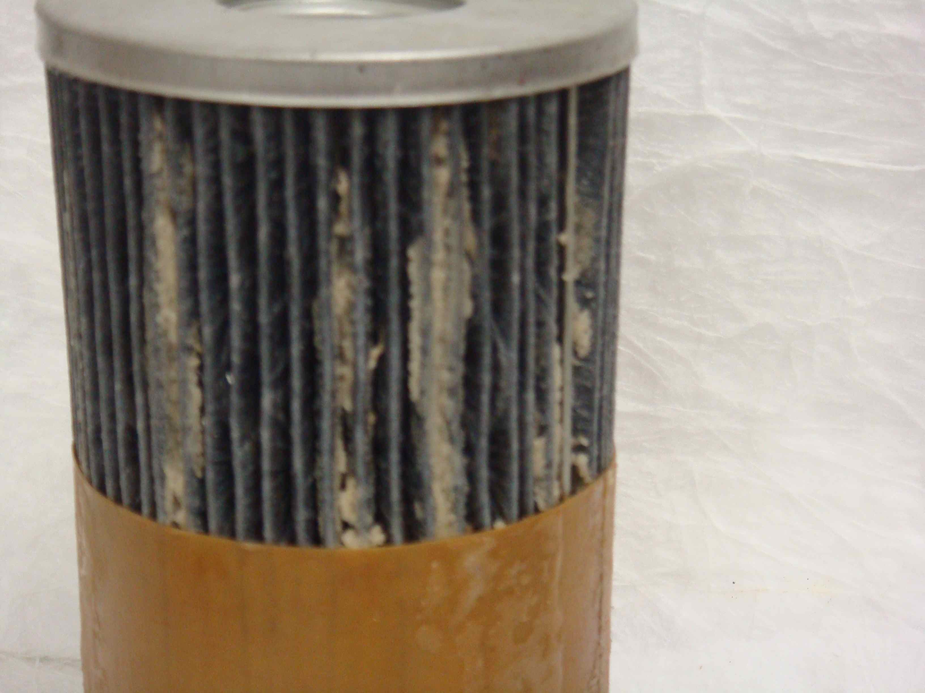
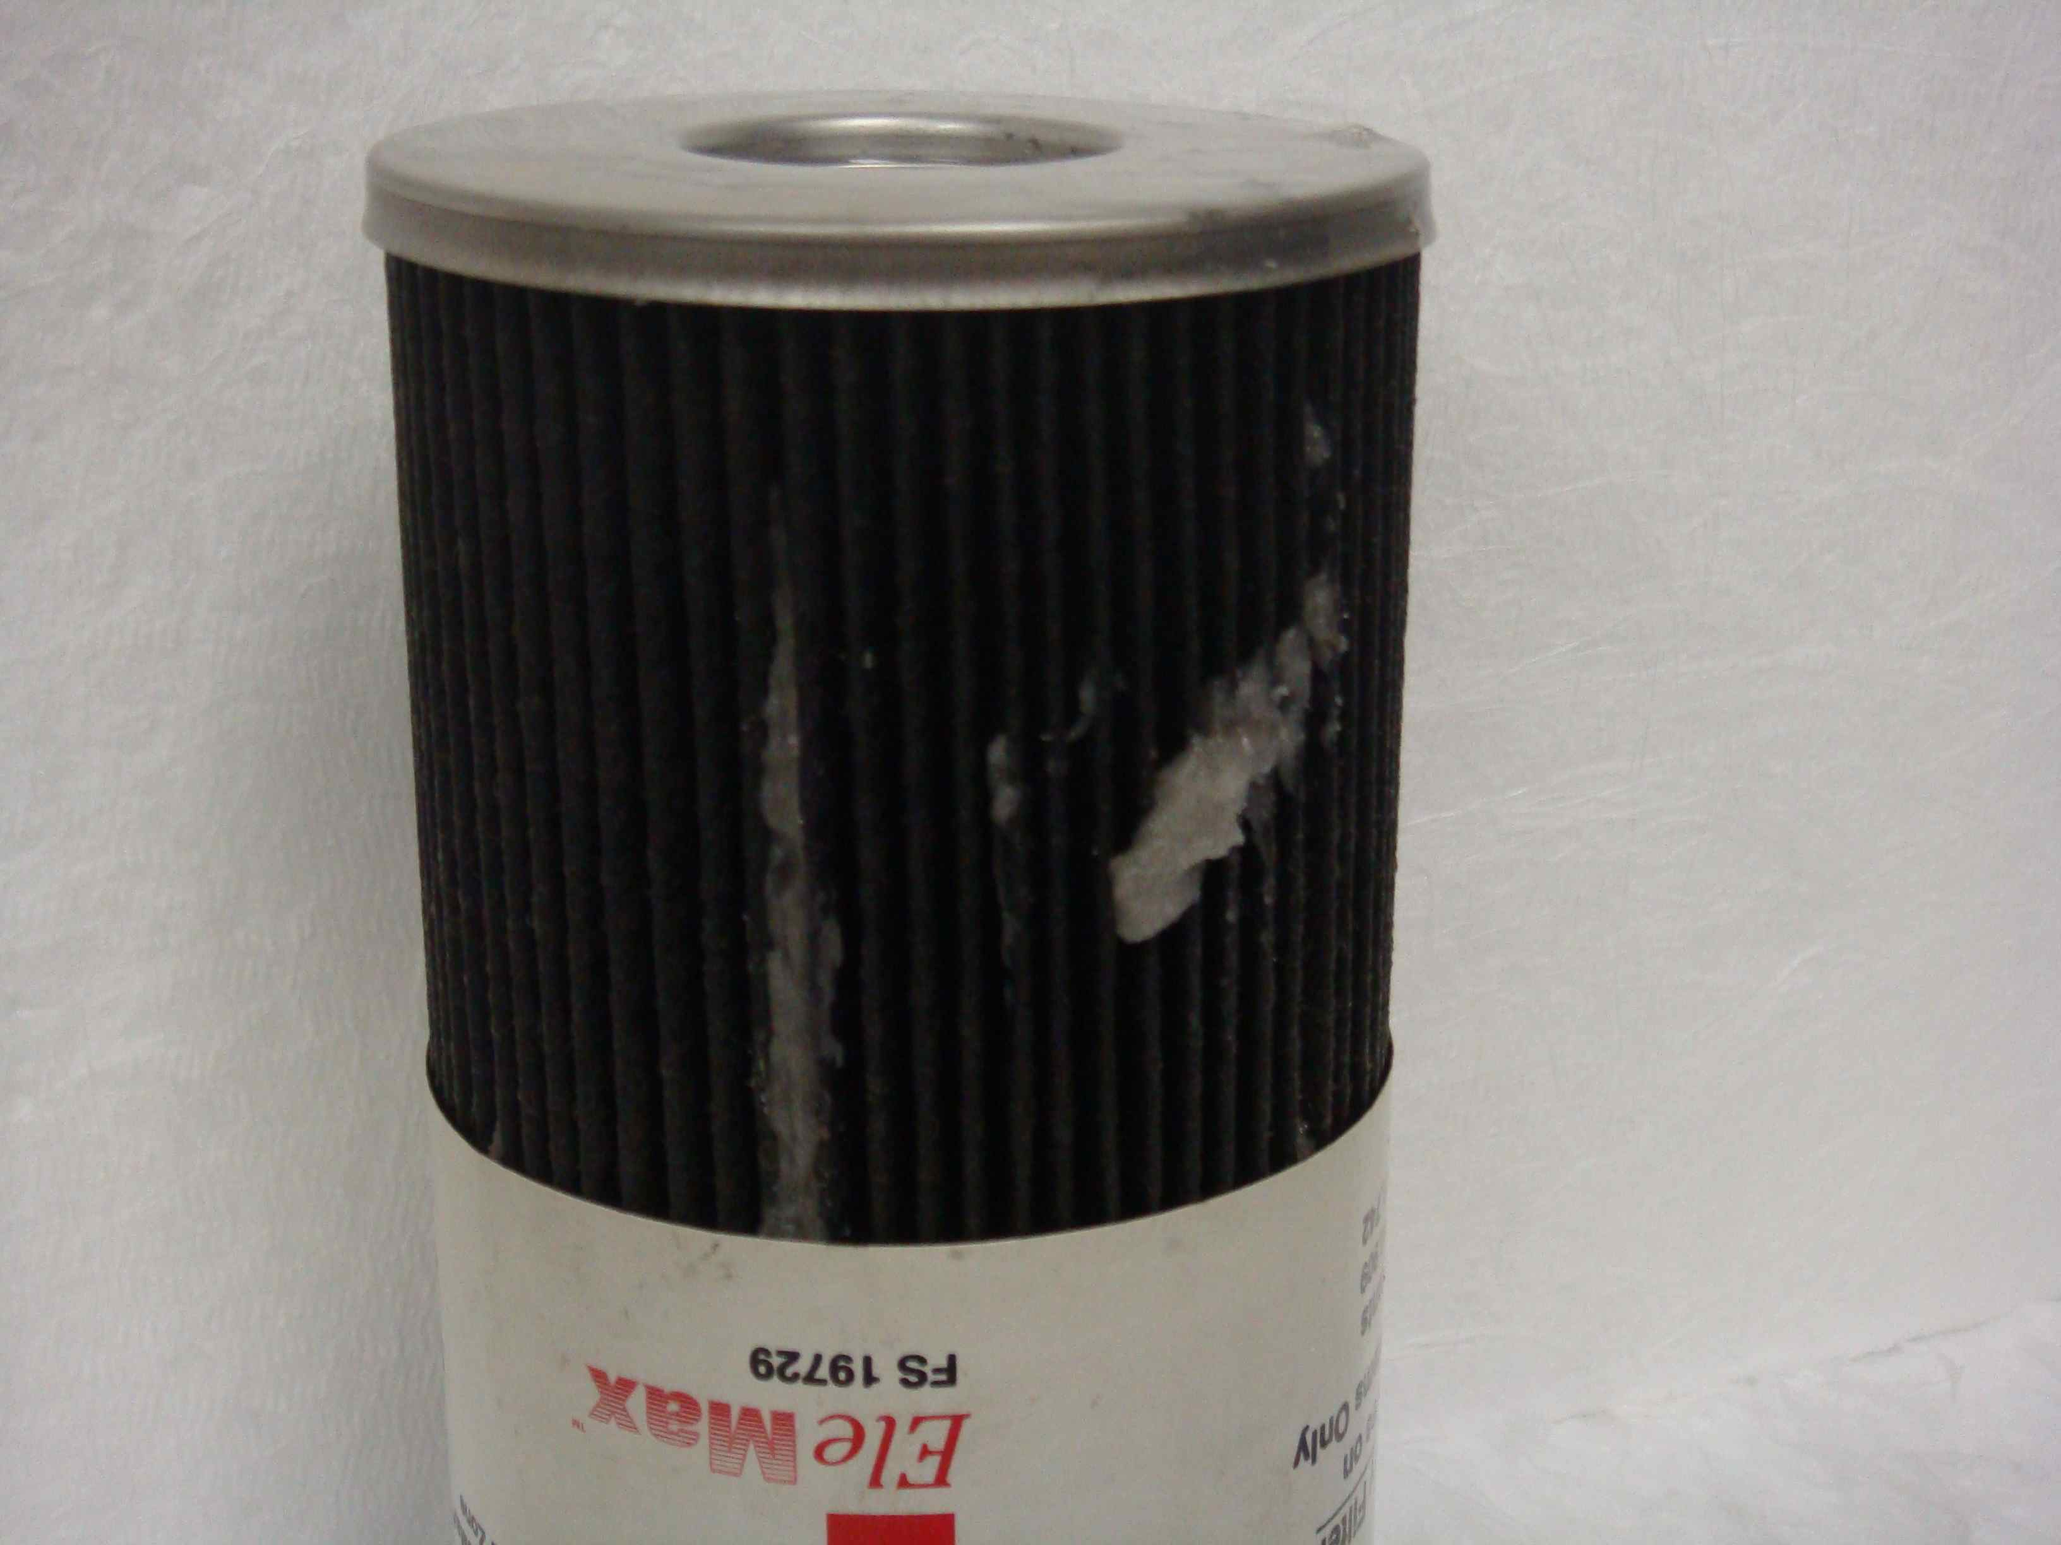
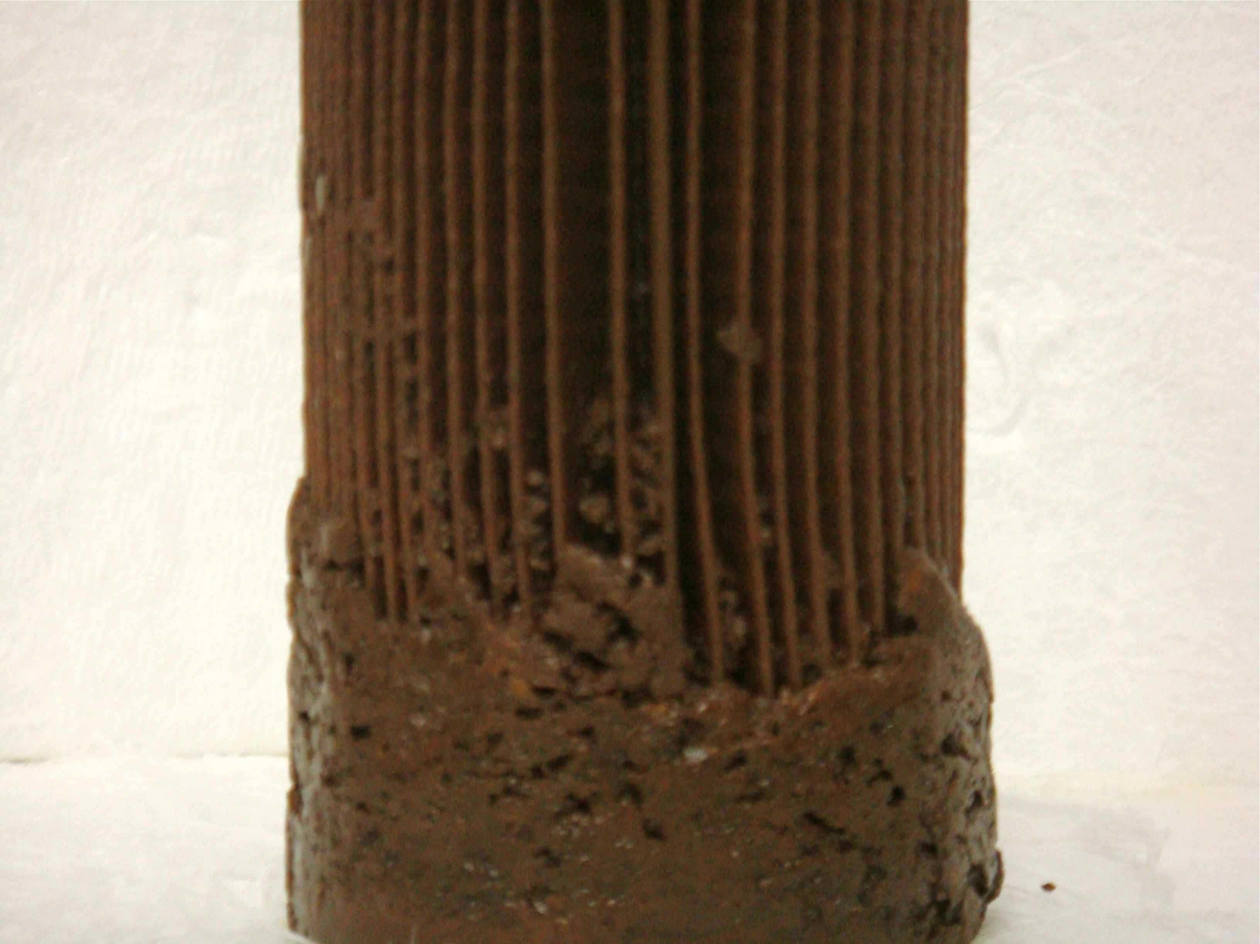
What does a Fuel Filter catch?
Paraffin Wax
Off-spec fuel
Rust
Notes:
This slide shows some fuel filters from on-going operations. Guess which one is biodiesel? The answer: None of them. The one on the top right is simply a high paraffin #2 Ultra Low Sulfur Diesel fuel whose cloud point was higher than the temperature outside and the paraffin froze out of solution and clogged the filter. We are seeing more and more high paraffin fuels, as paraffins are naturally made when hydrotreating diesel fuel to remove the sulfur content. This sample had nothing to do with biodiesel. In this case, the fuel supplier should have used an additive or taken more precautions for their customer, so the follow-up action there is to make sure your supplier is giving you a product that is suited for your use.
The sample on the bottom is also just conventional diesel fuel that came from a tank that had a significant amount of water bottoms which created rust that got trapped in the vehicle fuel filter. This happens more often than we might care to admit, but again this is a common diesel fuel issue and not related to biodiesel in any way. On-going tank monitoring and drainage of free water is the proper means to handle that issue.
The filter on the left was highly contaminated with mono-glycerides from an out of spec batch of biodiesel that had not gone to reaction completion. Since this batch was actually out of spec, that fuel was actually not real biodiesel. Buying from a BQ-9000 supplier to insure one gets good quality is the best way to eliminate that issue In that case, the user switched to a BQ-9000 company and their problems went away.
There have been a few isolated instances of monoglyceride clogging with #2 biodiesel, so if this happens with an in-spec #2 biodiesel the best way to eliminate that is for your supplier to use the #1 biodiesel that has a lower monoglyceride content.
The good news here is that the fuel filters were doing what they were supposed to be doing—catching debris and protecting the expensive high pressure common rail fuels system!
There is a common mis-conception that using biodiesel blends will automatically clog fuel filters. In reality, most fuel filter clogging observed with today’s high quality biodiesel blends are just the normal issues seen every day with petroleum based diesel fuel.
There is one exception to that when you first start using B20 sometimes, and we’ll cover that next.

Slide 24
Biodiesel Initial Cleaning Effect
B5 and Under
Same as petrodiesel, no special precautions needed
B20
Mild cleaning effect can happen upon first usage
Monitor filters, less than 2% need to be changed
    Then go back to normal fuel filter interval changes
Storage tanks may need to be cleaned, or keep extra filters on hand at start up
Housekeeping protocols for generic diesel equally important prior to blending
Notes:
Pure biodiesel is a good cleaner and can sometimes dissolve the sludge and buildup that has been left in fueling systems from years of petrodiesel use.
This effect has not been observed with B5 and lower blends to any extent so those blends are treated like normal diesel fuel.
When switching to B20 blends, in about 2% of the cases the presence of biodiesel may cause a fuel filter to clog until the system has been cleaned from sludge. Most of the time one change is sufficient, but in a few cases it has take 2 or 3 filter changes for the B20 to remove the petrodiesel sludge. Once the system has been cleaned, then one can go back to normal service intervals for fuel filters. Some believe the ongoing use of B20 helps to maintain fuel system cleanliness due to this factor.
For larger fueling storage tanks at say a garage, tanks may need to be cleaned or extra tank dispensers kept on hand as well. Good housekeeping and tank monitoring is a good idea for generic diesel, and its also a good idea for B20.

Slide 25
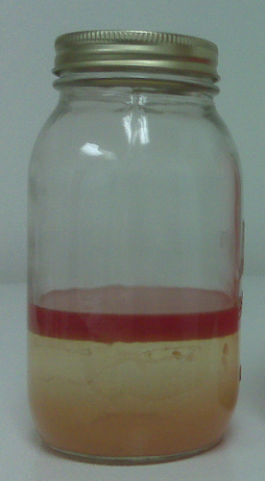
Water Contamination
ULSD reaches water saturation at approximately 50-250 ppm. More settles to the bottom.
NREL and EMA B20 survey data: B20 saturation level similar to that of petrodiesel, less than 200 ppm. More settles to the bottom
Water in solution is not problematic—free water is the main issue of concern
A hazy appearance in either petrodiesel or biodiesel can indicate free water and steps should be taken to remove it
Water in diesel freezes every winter giving some filter clogging due to ice crystals
Notes:
The issue of water contamination is one that is often misunderstood with biodiesel and biodiesel blends. This is primarily because of the issues with ethanol being water loving and people just automatically believe the same issues with ethanol exist with biodiesel. You may often here that biodiesel holds more water than diesel fuel.
Pure biodiesel, B100, can hold slightly more water than diesel fuel, as biodiesel can hold approximately 1500 ppm of water compared to diesel fuel at 50 to 250 ppm of water. While that is technically true, 1500 ppm is a very, very small amount of water (0.15%) and is actually similar to the amount of water gasoline holds (about 0.1%). Any water over that amount will come out of solution and drop to the bottom of biodiesel or diesel fuel. In fact, biodiesel processors use the fact that biodiesel doesn’t hold much water, as many utilize a water wash step to help remove minor components from the finished biodiesel in their manufacturing plant for B100.
Independent data from NREL and from the Engine Manufacturers Association shows that once you get to the B20 level, B20 and lower blends hold similar amounts of water as petrodiesel alone—all below 200 ppm of water. Any more water than that, and it falls to the bottom of the tank with either B20 or with petrodiesel. The biodiesel also stays completely blended with diesel fuel—even in the presence of water. This is a much different situation than ethanol in gasoline, as water is infinitely soluble in ethanol.
Keeping water out of tanks is always beneficial, as it is the free water that settles to the bottom which can cause issues, not the soluble water that is contained naturally in biodiesel blends or petrodiesel. A hazy appearance is a good indication of free water. A good preventative maintenance program of checking tanks for water and, if found, removing that water is always a good idea for both petrodiesel and biodiesel blends.

Slide 26
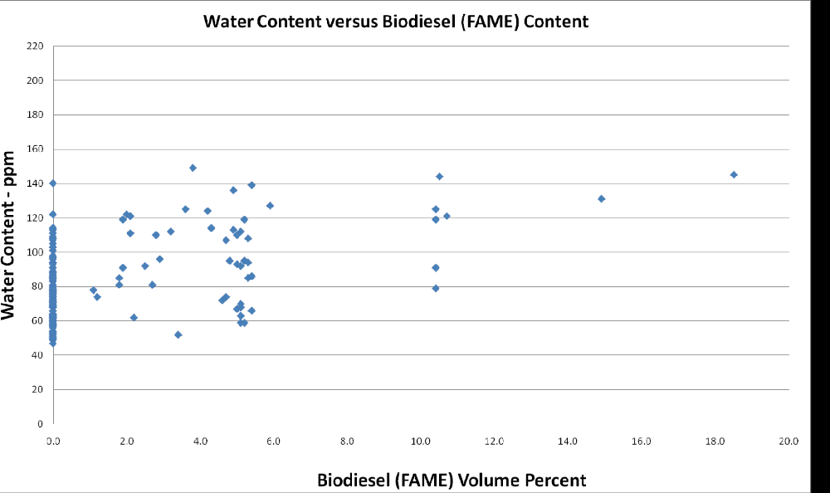
Engine Mfg Survey USA 2012
Notes:
To provide a bit more data, here is a recent survey that shows total water content (analyzed by Karl Fisher Moisture) vs. Biodiesel content. The petrodiesel all shows up on the zero percent biodiesel line. One can see that there is no difference between the range of water of petrodiesel and B20 or lower biodiesel blends.

Slide 27

Microbial Growth
Microbes are bacteria or fungus that live and propagate in fuel at the fuel/water interface.
    Water is needed to live—no water, no bugs.
Hydrocarbons in petrodiesel or biodiesel provide the food and the water provides the oxygen.
    This environment is needed for living, growth, and reproduction.
To avoid microbial problems with either petrodiesel or B20 blends, monitor free water in tanks, drain if needed
    Micro-organism test kits are also available to monitor growth
The filters with microbial contamination often had an odor different from the normal fuel smell.
The same treat method to eliminate microbial contamination for diesel fuels also work for B20 blends
Notes:
Micro-organisms have been found in diesel fuel forever, and seem to be an increasing issue since the advent of ultra low sulfur diesel fuel. They grow at the water interface at the bottom of the tank, living in the water but feeding off of the fuel—whether that is petrodiesel or biodiesel or a biodiesel blend. If micro-organisms are present in a high enough quantity they can clog a fuel filter. They are relatively easily treated with a variety of conventional biocides which kill the organisms which can then be filtered out. Keeping the water out of tanks on a regular basis can go a long way toward reducing or eliminating micro-organisms.
Filters with microbial growth appear black and slimy and typically have an odor different that is normal. There are a variety of microbial testing kits that users can buy to see if their fuel is starting to grow microbes. Its not desirable to regularly treat for microbes unless you actually have them, since you don’t want the microbes to develop a resistance to the biocide.

Slide 28
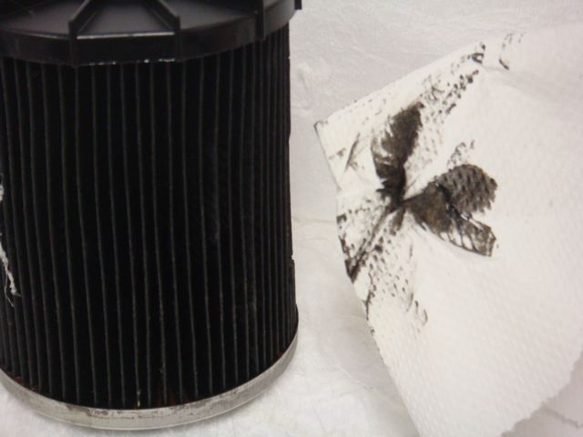
Thermal & Oxidative Stability
Chemical degradation occurs with contact with oxygen for long periods or at high temperatures.
Oxidation of diesel fuel can form problematic degradation products
Degradation products can increase deposits and gumming on fuel pumps and injection systems
Filter plugging can also occur
The biodiesel specification contains parameters for insuring adequate fuel stability for normal applications
The shelf life of biodiesel blends is recommended by NBB as 6 months
Stability additives available on the open market
Notes:
Read the slide as is.
One thing we are starting to see reported more and more often with petrodiesel alone are black filters like the above from high pressure common rail fuel systems. Fuel get pressurized almost to hydraulic pressures, and often gets very hot in the fuel rail. Some fuel is now circulated back into the fuel tank as well. This phenomenon is currently being studied with diesel to determine if additional specifications are needed on stability for conventional diesel fuel. Biodiesel is very thermally stable, and already has an oxidative stability spec, so biodiesel is not thought to be involved but further testing with both petrodiesel and B20 with HPCR systems is currently in progress.

Slide 29
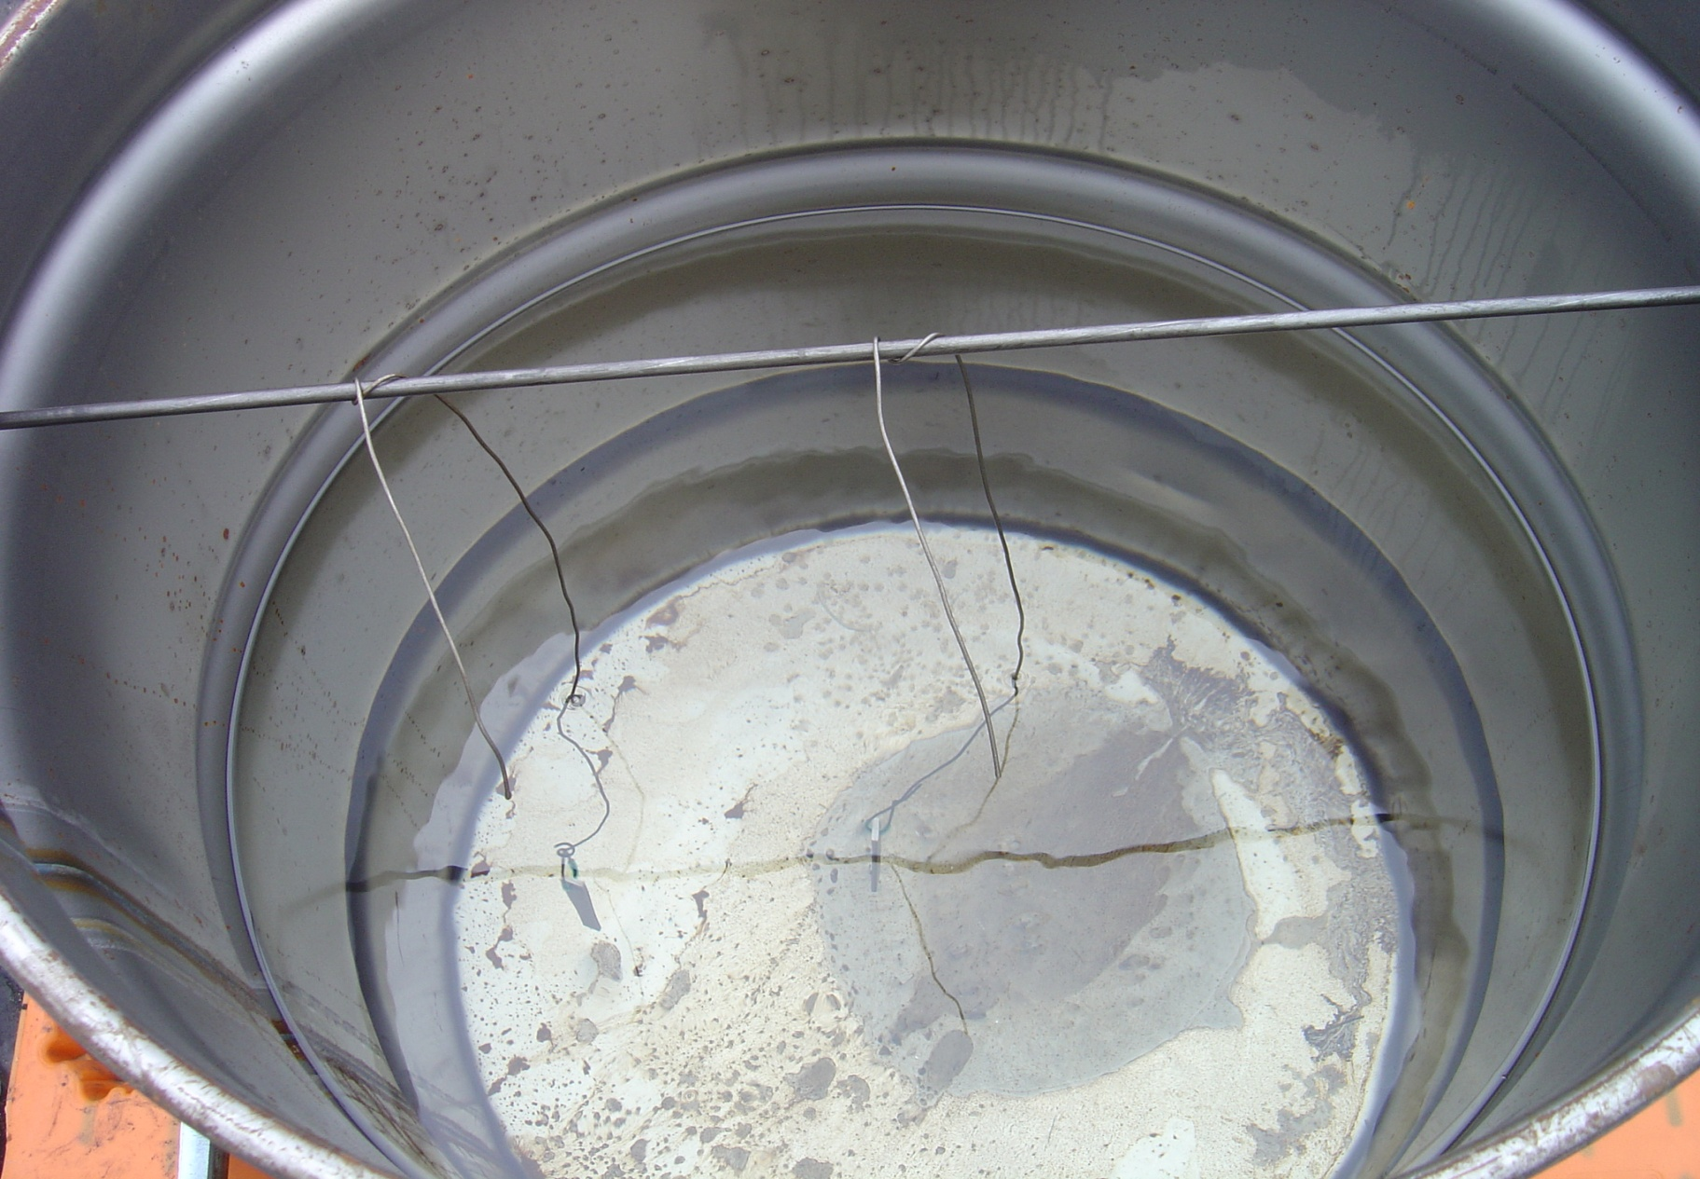
In specification B100
Notes:
To show what can happen with off-spec fuel, a study was performed to quantify the negative impacts it may have. Here is a 55 gallon drum that stored a B20 blend made with in-spec biodiesel. A small metal coupon was suspended in the fuel, which is the wire you can see dangling from the horizontal rod across the drum. Everything is nice and clean, no issues with the in-spec B20.

Slide 30
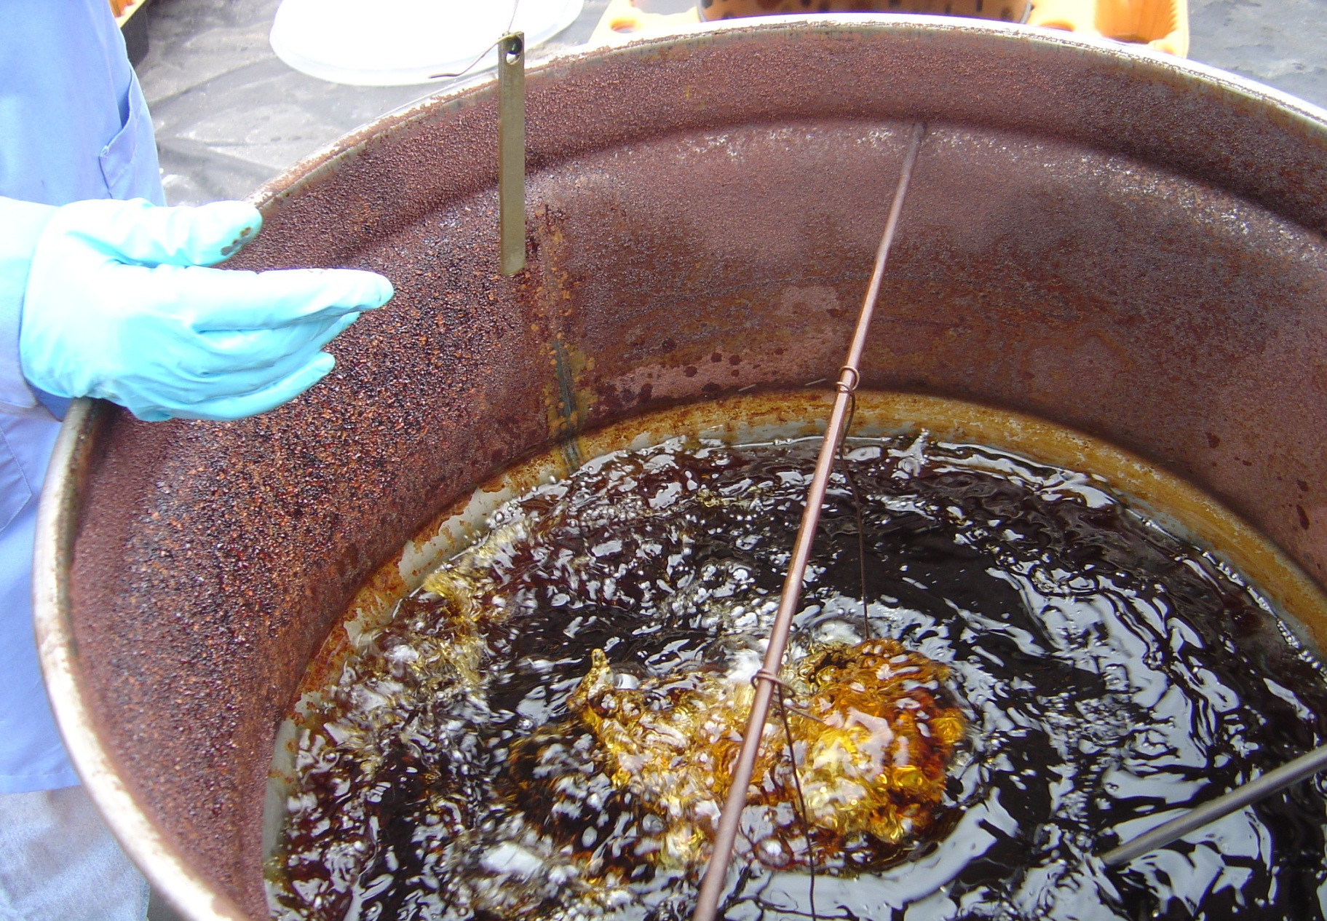
Out of spec: High raw oil
Notes:
Here is an example of what can happen with out of spec fuel. This particular batch had a high amount of raw vegetable oil. The occurrence of this in the market is relatively rare, and a good thing too!

Slide 31
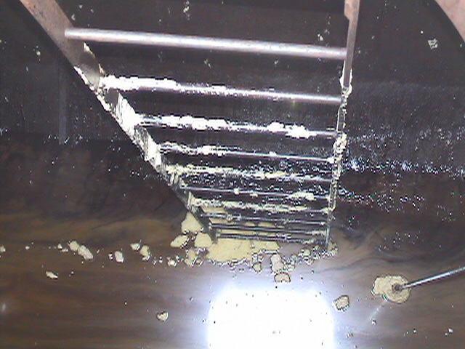
Out of spec: Incomplete reaction and high catalyst conc.
Notes:
Here is a picture of an actual B100 tank at a military base. In this particular case, the biodiesel was not properly processed—it had high catalyst concentration and high levels of incomplete reaction products (saturated mono-glycerides, soaps).

Slide 32



Notes:
Read Bullets

Slide 33
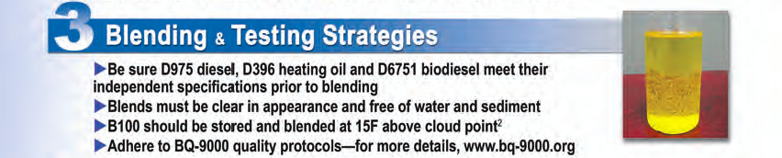


Notes:
Read Bullets

Slide 34
Fuel Quality Information
The National Renewable Energy Laboratory (NREL) Biodiesel Use & Handling Guidelines at: http://www.nrel.gov/vehiclesandfuels/pdfs/43672.pdf
www.biodiesel.org
http://www.bq-9000.org/
Notes:
Read the slide as is.

Slide 35

Biodiesel Resources
www.biodiesel.org
  Biodiesel Training Toolkit
  News Releases & Information Resources
  Technical Library, Spec Sheets & Videos
  OEM Warranty Positions on Biodiesel
  U.S. Diesel Vehicle List
www.BQ-9000.org
  Listing of BQ-9000 Certified Companies
www.biotrucker.com
  Listing of BioTrucker retail sites
Notes:
Here are other resources for your reference.

